Slide 1


Noida Institute of Engineering and Technology, Greater Noida
Statistics & Probability
AAS0303
Unit: IV
Test of Hypothesis & Statistical Inference
Dr. Anil Agarwal
Associate Professor
Department of Mathematics
Branch: AIML/AI/DS
3rd Semester

Slide 2

Faculty Introduction
Name : Dr. Anil Agarwal
Designation: Associate professor
Department: Mathematics

Slide 3
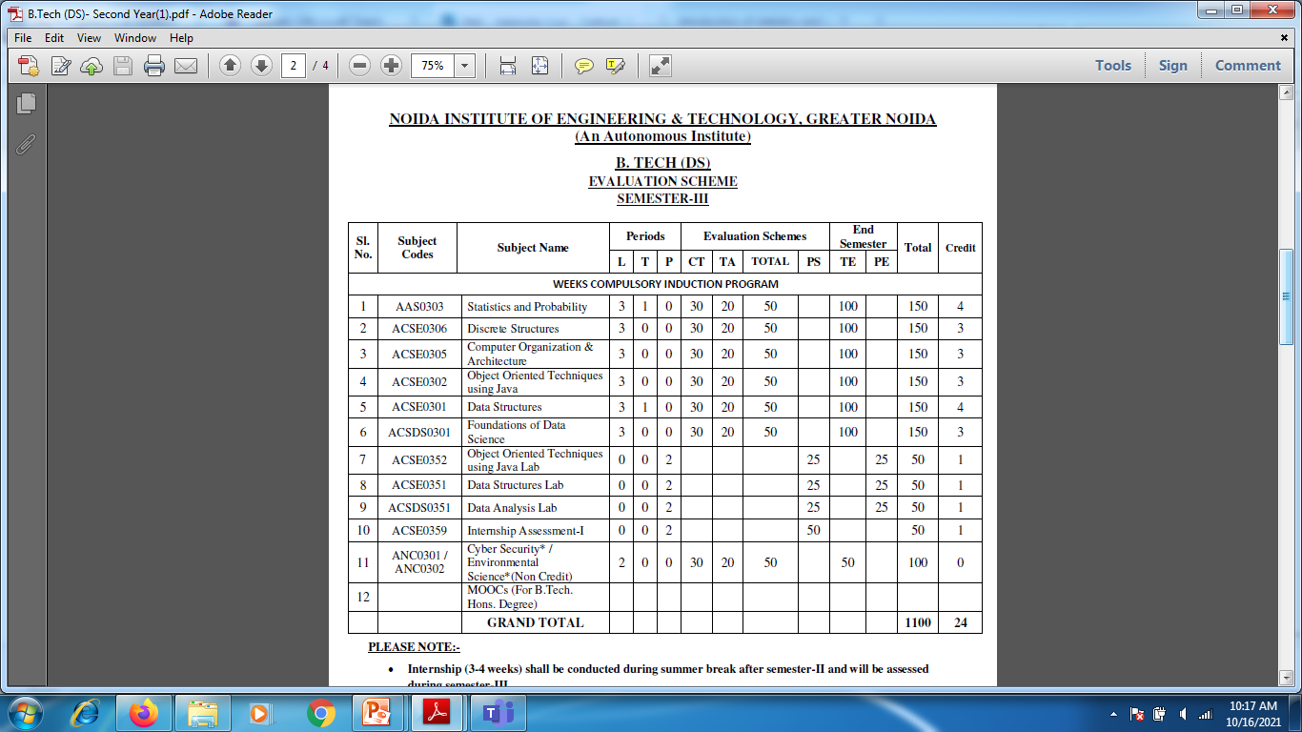
Evaluation Scheme

Slide 4
Syllabus

Slide 5
Content
Introduction of Sampling & Population
Error in Sampling and Sampling distributions
Test of hypothesis – p value
Z-Test
T-Test(for mean)
Confidence Intervals
F-Test
Chi-square test
One way ANOVA
Statistical Inference, Parameter estimation
Least Square estimation method
Maximum Likelihood estimation

Slide 6
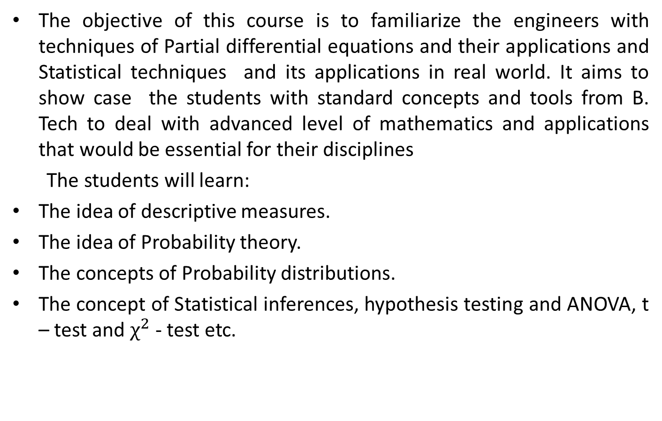
Course Objective
The objective of this course is to familiarize the engineers with techniques of Partial differential equations and their applications and Statistical techniques and its applications in real world. It aims to show case the students with standard concepts and tools from B. Tech to deal with advanced level of mathematics and applications that would be essential for their disciplines
The students will learn:
The idea of descriptive measures.
The idea of Probability theory.
The concepts of Probability distributions.
The concept of Statistical inferences, hypothesis testing and ANOVA, t – test and $χ^{2}$ - test etc.

Slide 7
Course Outcome
CO1:Remember the concept of central tendency & dispersion of data.
CO2:Understand the concept of Probability and random variable.
CO3:Understand and remember the concept of Probability distributions
CO4:Apply the concept of Statistical Inference, hypothesis testing, Maximum likelihood estimation etc.
CO5: Understand the problems of Time & Work, Pipe & Cistern, Boat & Stream, Speed, distance & time etc

Slide 8
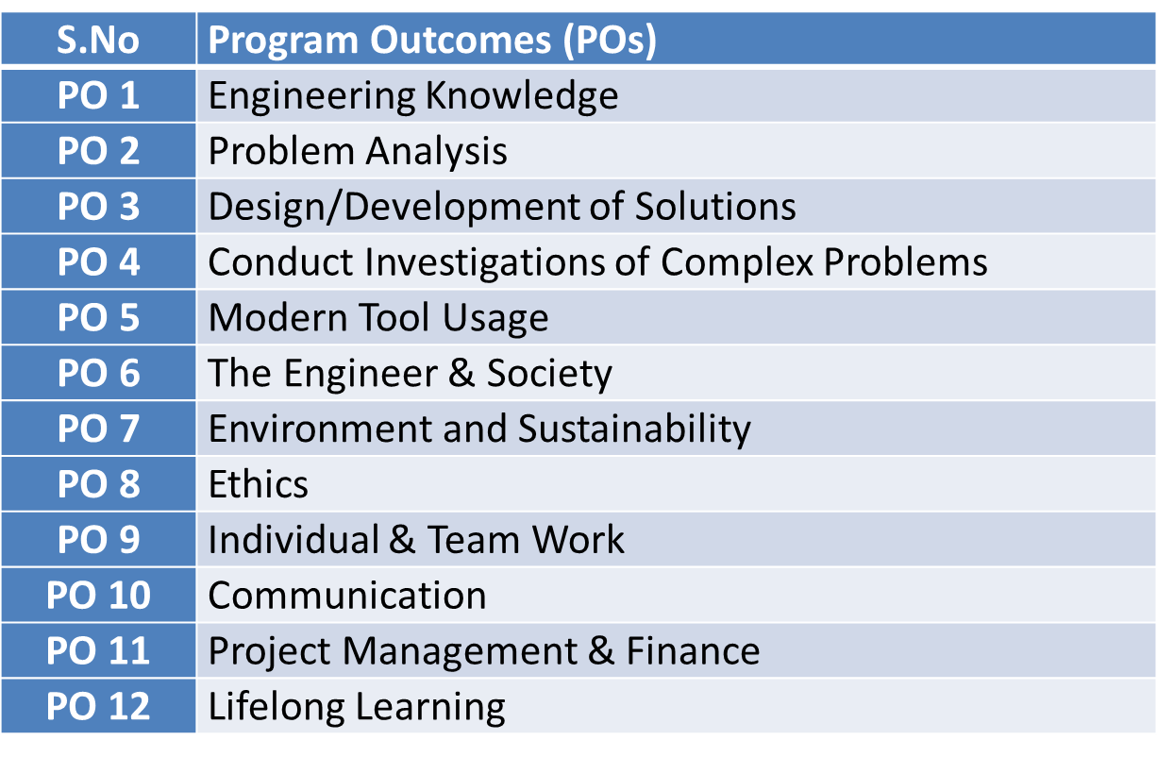
Program Outcomes

Slide 9

PSO

Slide 10
CO-PO Mapping(CO4)
Sr. No | Course Outcome | PO1 | PO2 | PO3 | PO4 | PO5 | PO6 | PO7 | PO8 | PO9 | PO10 | PO11 | PO12
1 | CO 1 | H | H | H | H | L | L | L | L | L | L | L | M
2 | CO 2 | H | H | H | H | L | L | L | L | L | L | M | M
3 | CO 3 | H | H | H | H | L | L | L | L | L | L | M | M
4 | CO 4 | H | H | H | H | L | L | L | L | L | L | L | M
5 | CO 5 | H | H | H | H | L | L | L | L | L | L | M | M
*L= Low *M= Medium *H= High

Slide 11
CO-PSO Mapping(CO4)
*L= Low *M= Medium *H= High
CO | PSO 1 | PSO 2 | PSO 3
CO.1 | H | L | M
CO.2 | L | M | L
CO.3 | M | M | M
CO.4 | H | M | M
CO.5 | H | M | M

Slide 12
Prerequisite and Recap(CO4)
Knowledge of Descriptive measures
Knowledge of Probability theory and random variable.

Slide 13
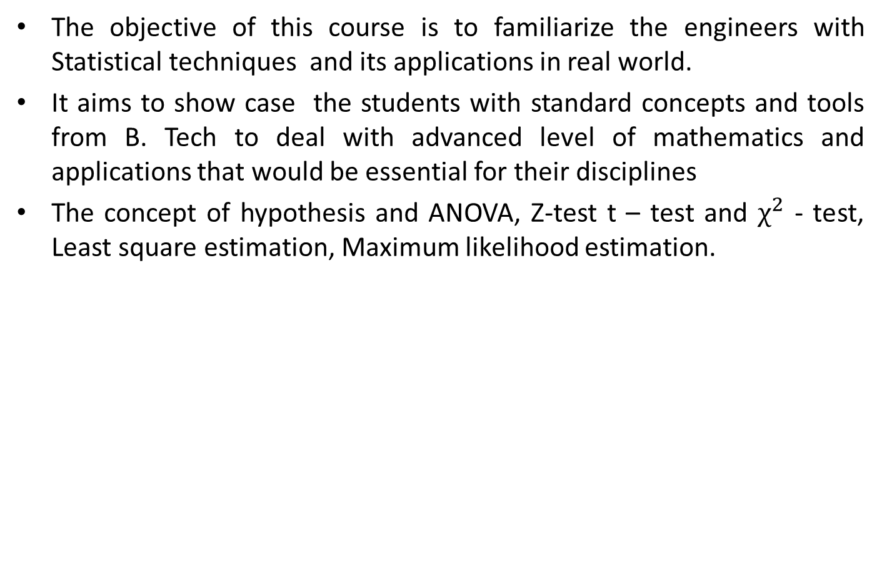
Unit Objective(CO4)
The objective of this course is to familiarize the engineers with Statistical techniques and its applications in real world.
It aims to show case the students with standard concepts and tools from B. Tech to deal with advanced level of mathematics and applications that would be essential for their disciplines
The concept of hypothesis and ANOVA, Z-test t – test and $χ^{2}$ - test, Least square estimation, Maximum likelihood estimation.

Slide 14
Topic objective (CO4)
Test of Hypothesis
Describe real-life examples to explain the motivation behind hypothesis

Slide 15
Test of Hypothesis (CO4)
Test of Hypothesis:
Some information about a characteristic of the population is known, we wish to know whether the information can be accepted or rejected, we choose a random sample and obtain information about the characteristic, based on this information.
we conclude whether the available information of the characteristic of the population can be accepted or rejected. This is called Test of hypothesis.

Slide 16
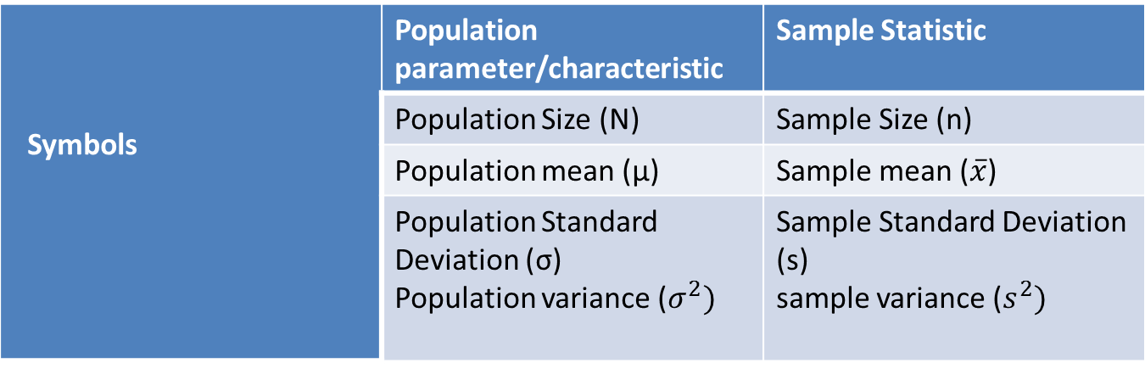
Test of Hypothesis (CO4)
Symbols for Population & Samples:

Slide 17
Test of Hypothesis (CO4)
Procedure of Test of hypothesis
State Null hypothesis & Alternate hypothesis
Define level of significance
Use suitable test statistics
Establish critical region (Table value)
Conclusion

Slide 18
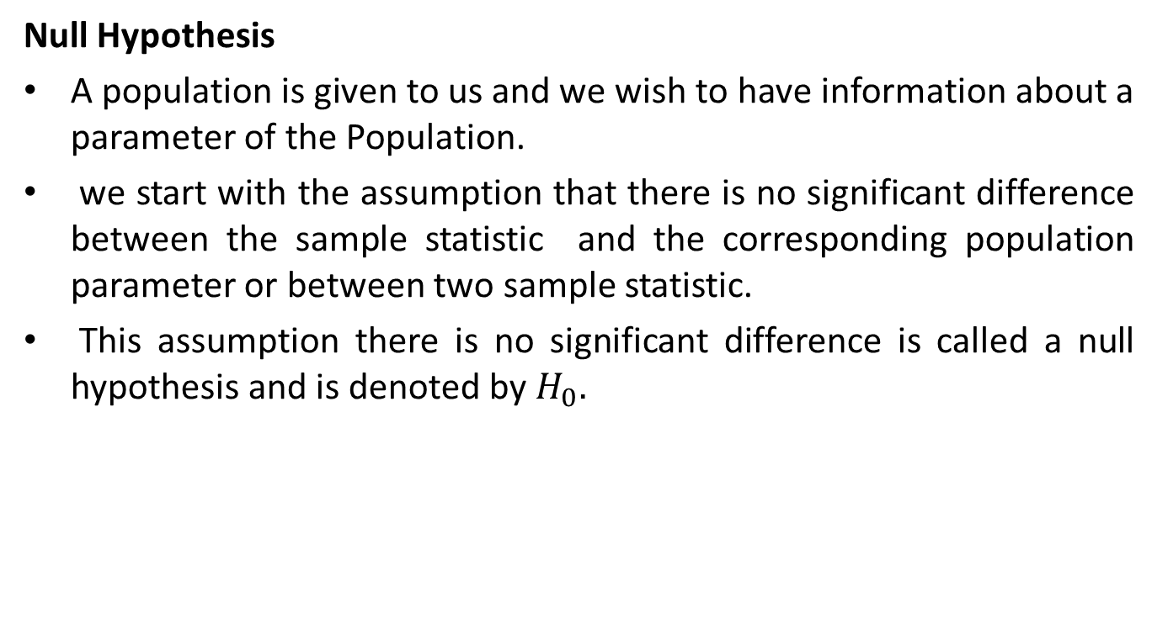
Test of Hypothesis (CO4)
Null Hypothesis
A population is given to us and we wish to have information about a parameter of the Population.
we start with the assumption that there is no significant difference between the sample statistic and the corresponding population parameter or between two sample statistic.
This assumption there is no significant difference is called a null hypothesis and is denoted by $H_{0}.$

Slide 19
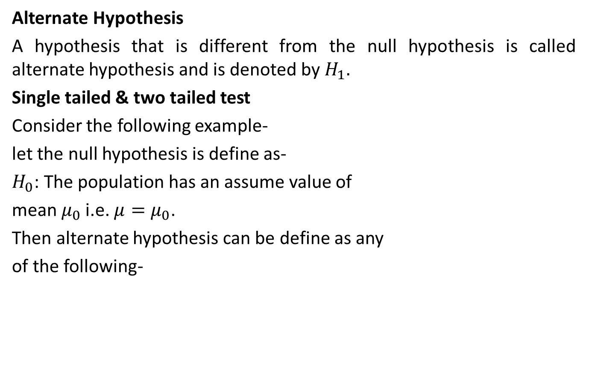
Test of Hypothesis (CO4)
Alternate Hypothesis
A hypothesis that is different from the null hypothesis is called alternate hypothesis and is denoted by $H_{1}.$
Single tailed & two tailed test
Consider the following example-
let the null hypothesis is define as-
$H_{0}$: The population has an assume value of
mean $μ_{0}$ i.e. $μ=μ_{0}$.
Then alternate hypothesis can be define as any
of the following-

Slide 20
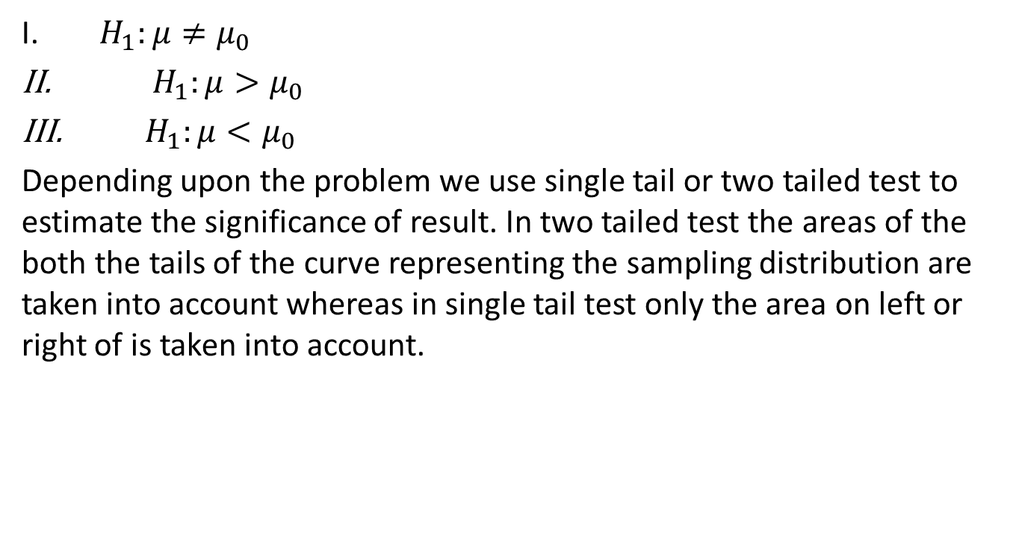
Test of Hypothesis (CO4)
$H_{1}:μ≠μ_{0}$
${ H}_{1}:μ>μ_{0}$
${ H}_{1}:μ<μ_{0}$
Depending upon the problem we use single tail or two tailed test to estimate the significance of result. In two tailed test the areas of the both the tails of the curve representing the sampling distribution are taken into account whereas in single tail test only the area on left or right of is taken into account.

Slide 21
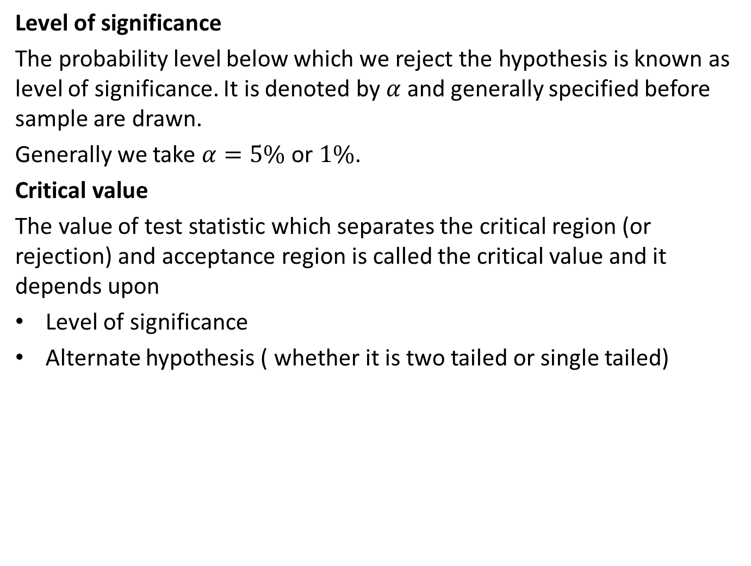
Test of Hypothesis (CO4)
Level of significance
The probability level below which we reject the hypothesis is known as level of significance. It is denoted by $α$ and generally specified before sample are drawn.
Generally we take $α=5\%$ or $1\%$.
Critical value
The value of test statistic which separates the critical region (or rejection) and acceptance region is called the critical value and it depends upon
Level of significance
Alternate hypothesis ( whether it is two tailed or single tailed)

Slide 22
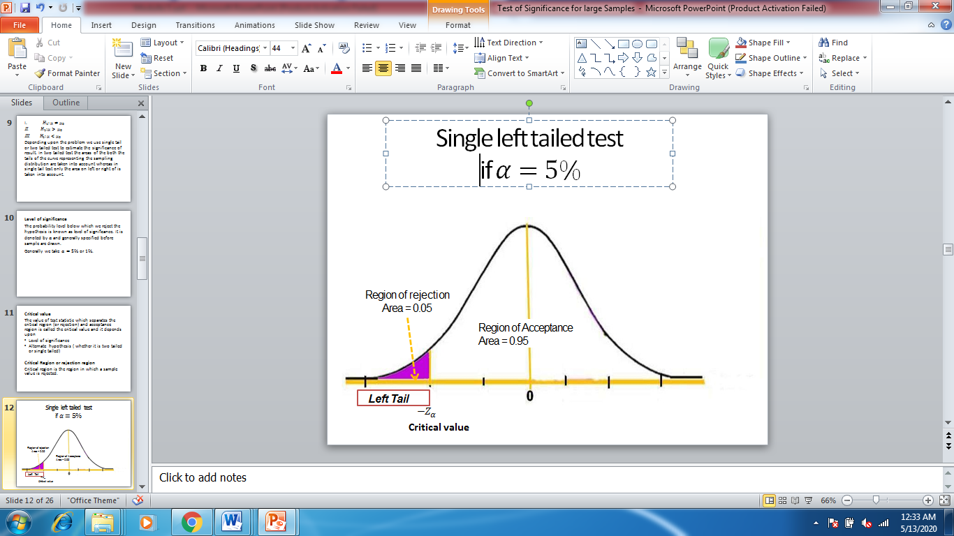
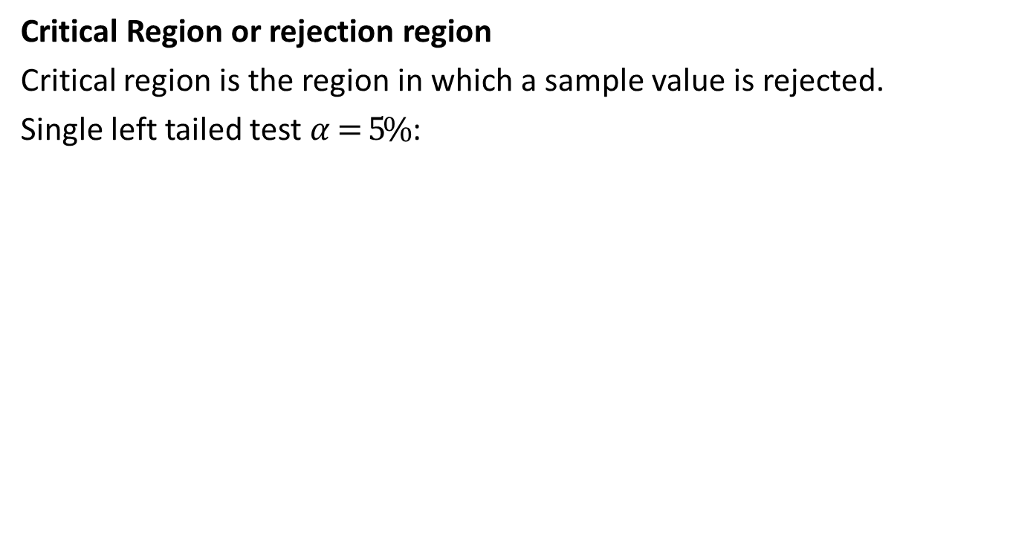
Test of Hypothesis (CO4)
Critical Region or rejection region
Critical region is the region in which a sample value is rejected.
Single left tailed test $α=5\%$ :

Slide 23
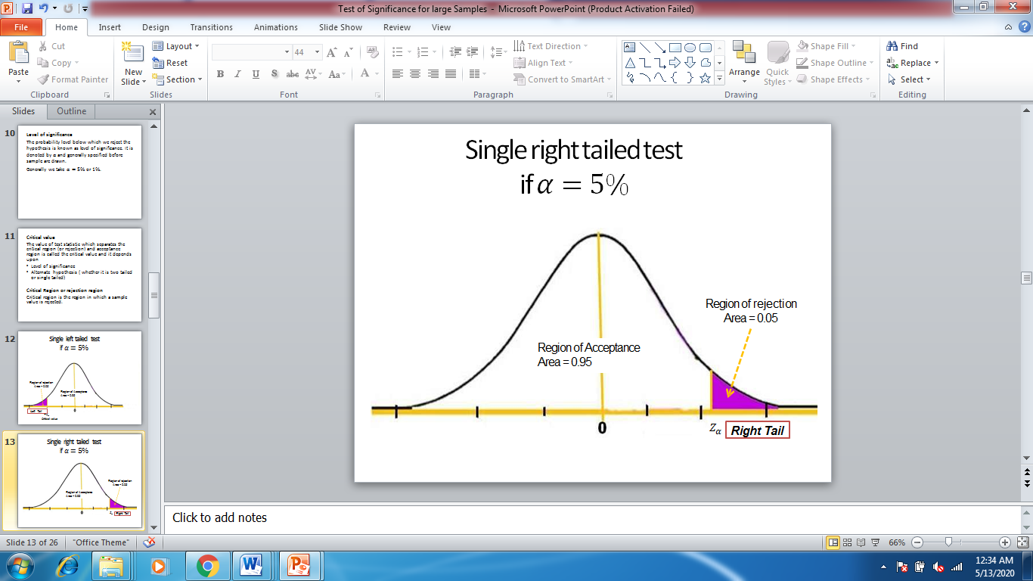
Test of Hypothesis (CO4)

Slide 24
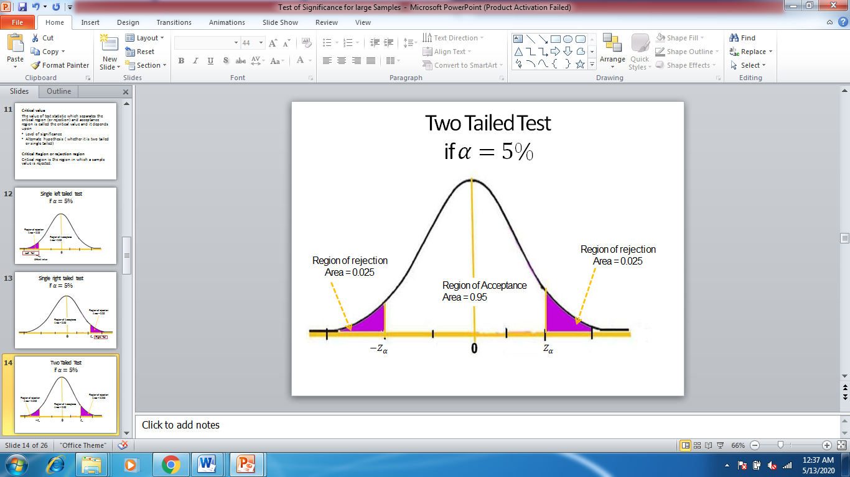
Test of Hypothesis (CO4)

Slide 25
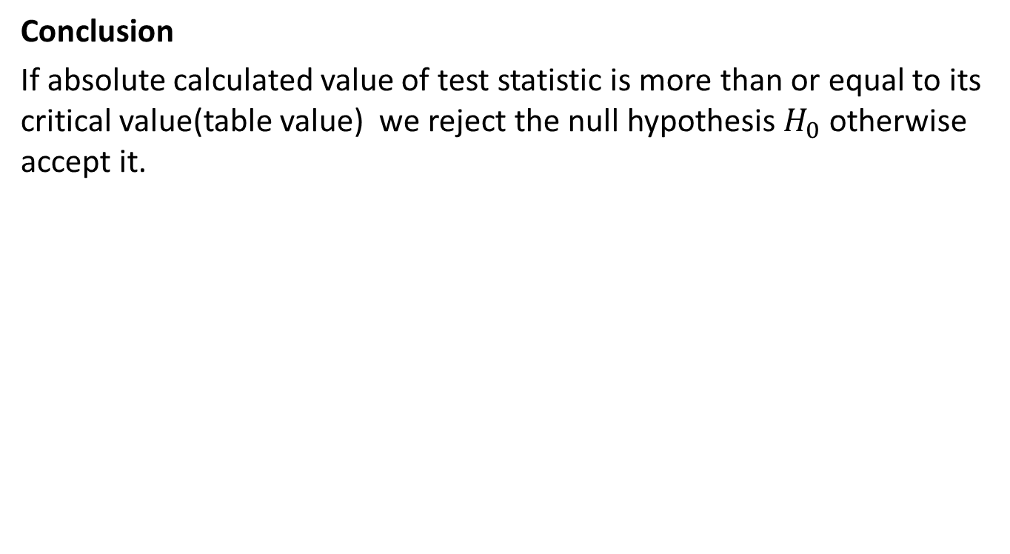
Test of Hypothesis (CO4)
Conclusion
If absolute calculated value of test statistic is more than or equal to its critical value(table value) we reject the null hypothesis $H_{0}$ otherwise accept it.

Slide 26
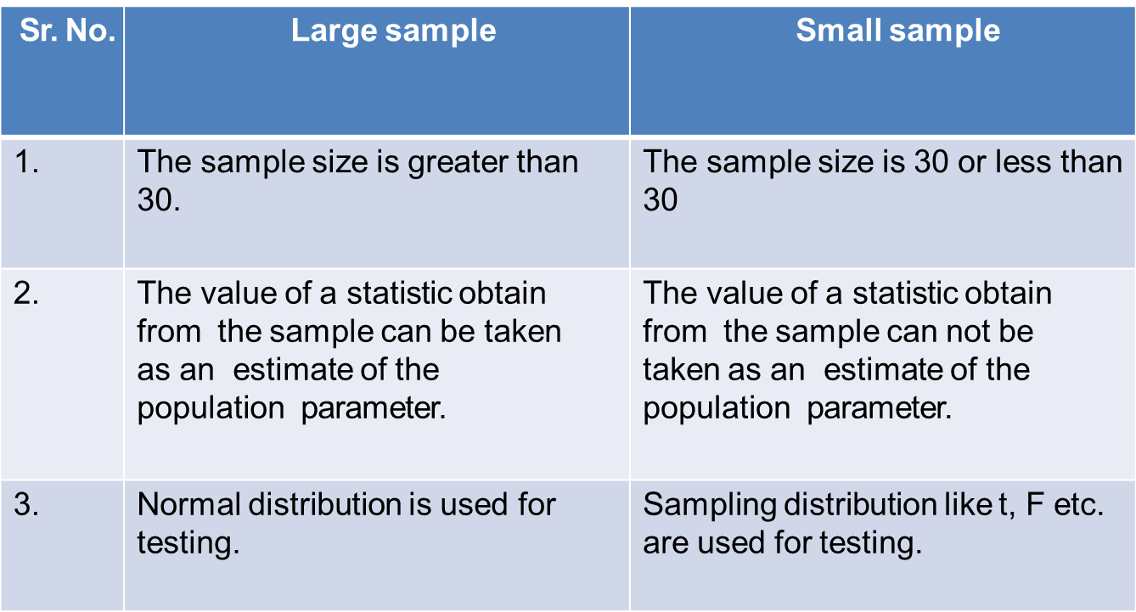
Test of Hypothesis (CO4)
Test of hypothesis for large samples and Small samples
Difference between Large and Small sample

Slide 27
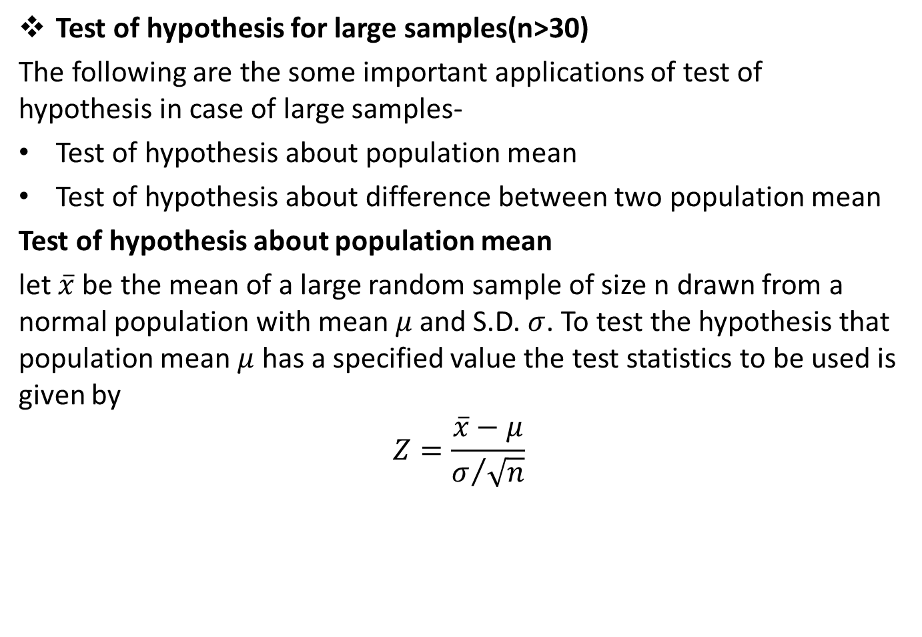
Test of Hypothesis (CO4)
Test of hypothesis for large samples(n>30)
The following are the some important applications of test of hypothesis in case of large samples-
Test of hypothesis about population mean
Test of hypothesis about difference between two population mean
Test of hypothesis about population mean
let $\overline{x}$ be the mean of a large random sample of size n drawn from a normal population with mean $μ$ and S.D. $σ$. To test the hypothesis that population mean $μ$ has a specified value the test statistics to be used is given by
$$Z=\frac{\overline{x}−μ}{σ/{\sqrt{n}}}$$

Slide 28
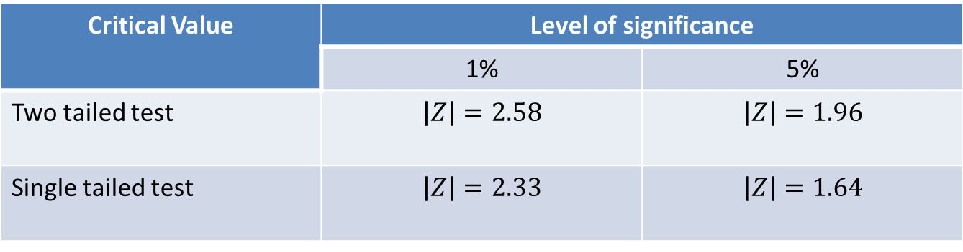
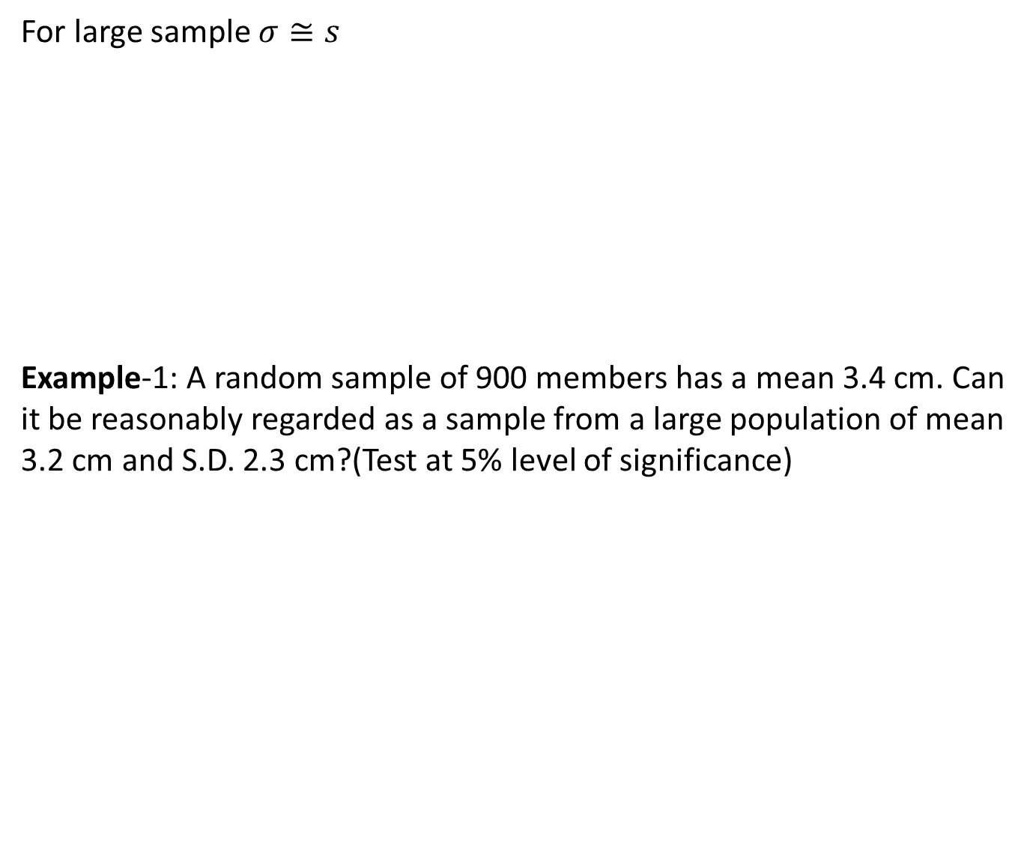
Test of Hypothesis (CO4)
For large sample $σ≅s$
Example-1: A random sample of 900 members has a mean 3.4 cm. Can it be reasonably regarded as a sample from a large population of mean 3.2 cm and S.D. 2.3 cm?(Test at 5% level of significance)

Slide 29
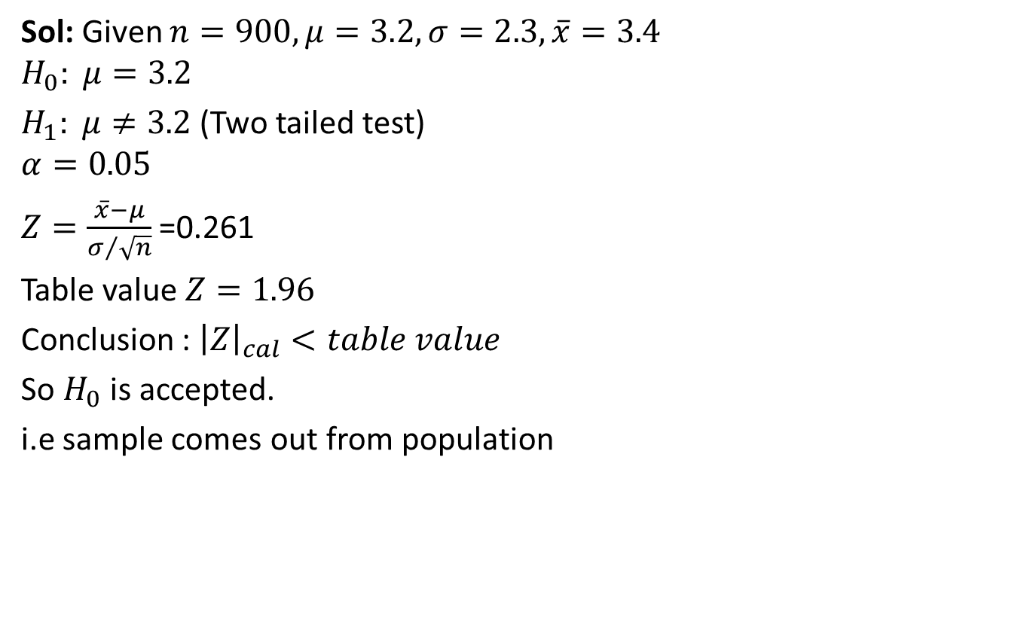
Test of Hypothesis (CO4)
Sol: Given $n=900, μ=3.2, σ=2.3,\overline{x}=3.4$
$$H_{0}: μ=3.2$$
$H_{1}: μ≠3.2$(Two tailed test)
$$α=0.05$$
$Z=\frac{\overline{x}−μ}{σ/{\sqrt{n}}}$ =0.261
Table value $Z=1.96$
Conclusion : ${\left|Z\right|}_{cal}<table value$
So $H_{0}$ is accepted.
i.e sample comes out from population

Slide 30
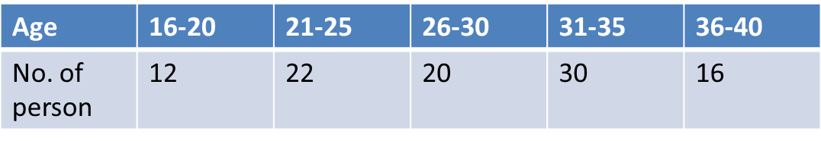
Test of Hypothesis (CO4)
Example-2: An insurance agent has claimed that the avg. age of policy holders who insure through him is less then the avg. age of all agents which is 30.5 yrs.
A random sample of 100 policy holders who had insured through him gave the following age distribution-
Calculate arithmetic mean and standard deviation(S.D.) of this distribution and test his claim at 5% level of significance.

Slide 31
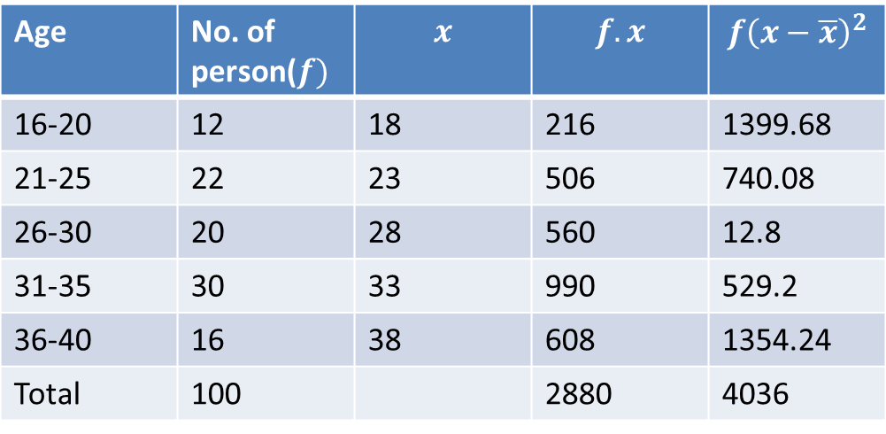
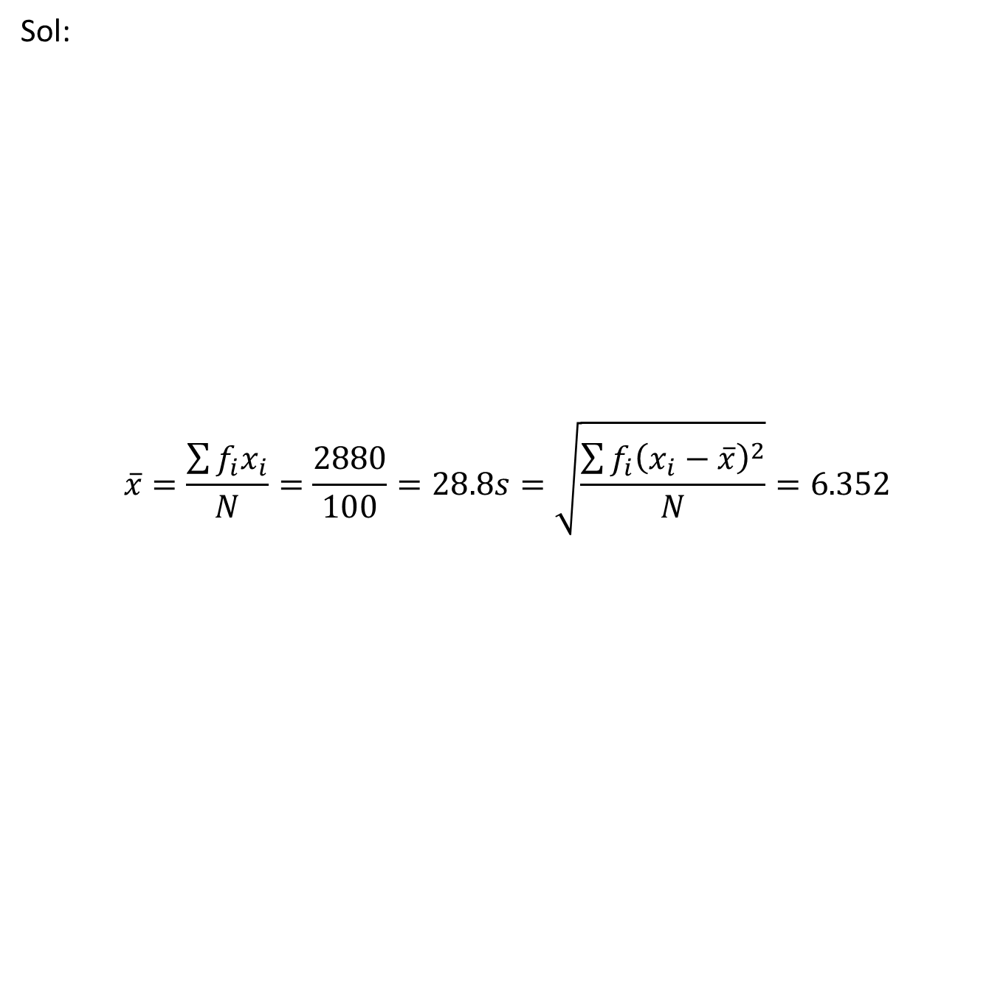
Test of Hypothesis (CO4)
Sol:
$$\overline{x}=\frac{\sum{f_{i}x_{i}}}{N}=\frac{2880}{100}=28.8s=\sqrt{\frac{\sum{f_{i}{\left(x_{i}−\overline{x}\right)}^{2}}}{N}}=6.352$$

Slide 32
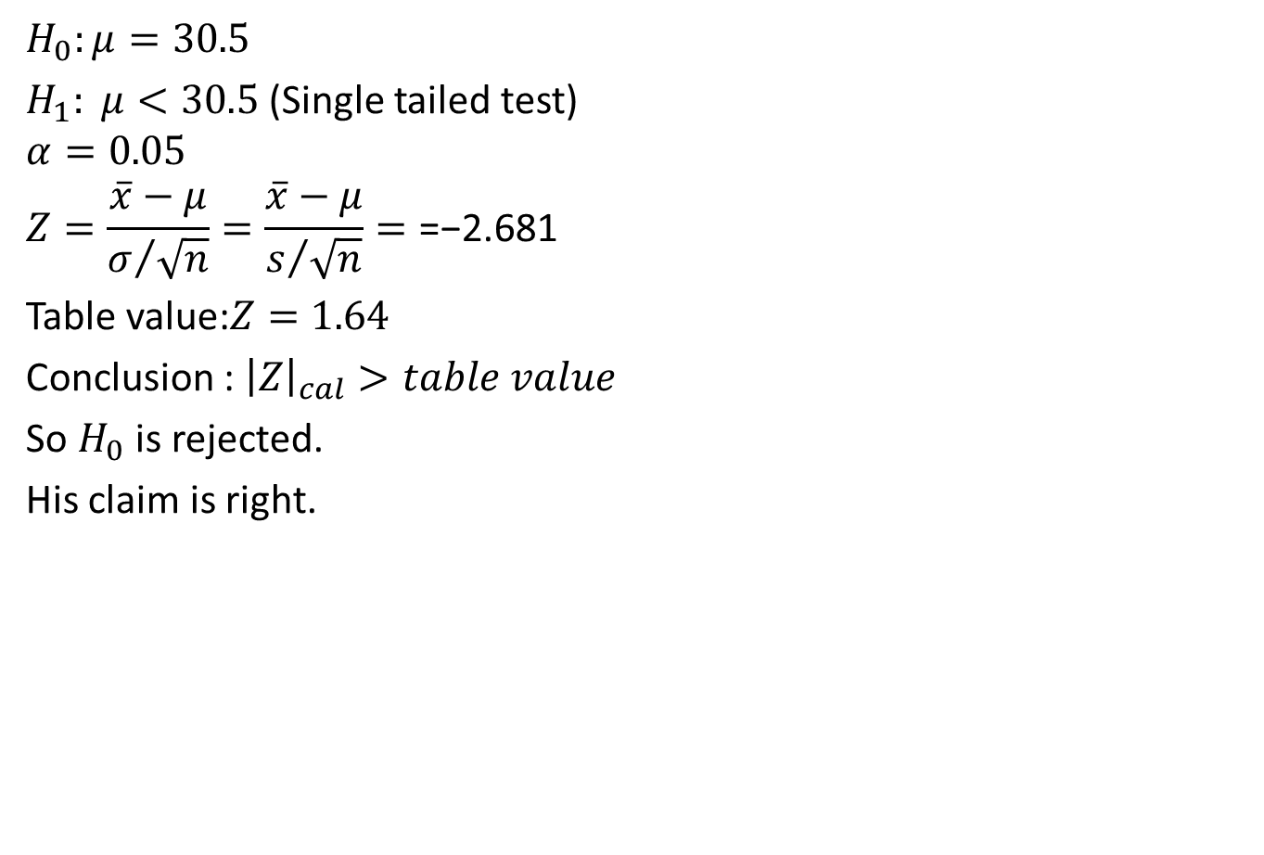
Test of Hypothesis (CO4)
$$H_{0}:μ=30.5$$
$H_{1}: μ<30.5$ (Single tailed test)
$$α=0.05$$
$$Z=\frac{\overline{x}−μ}{σ/{\sqrt{n}}}=\frac{\overline{x}−μ}{s/{\sqrt{n}}}=\text{=−2.681}$$
Table value:$Z=1.64$
Conclusion : ${\left|Z\right|}_{cal}>table value$
So $H_{0}$ is rejected.
His claim is right.

Slide 33
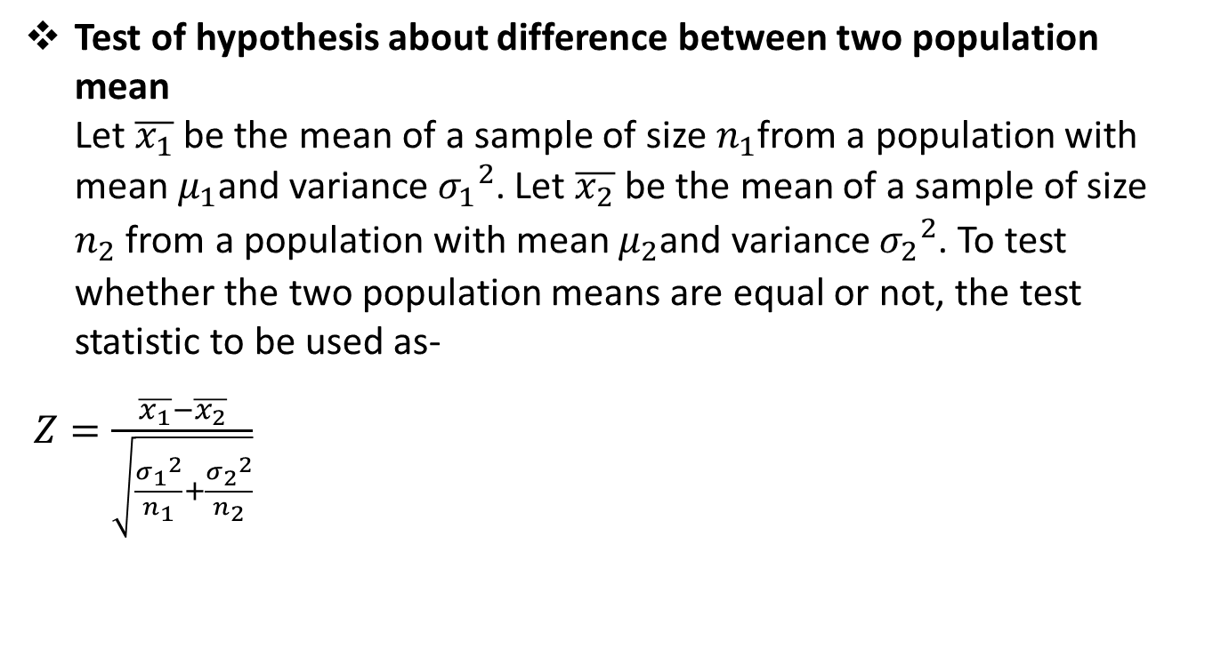
Test of Hypothesis (CO4)
Test of hypothesis about difference between two population mean Let $\overline{x_{1}}$ be the mean of a sample of size $n_{1}$from a population with mean $μ_{1}$and variance ${σ_{1}}_{}^{2}$. Let $\overline{x_{2}}$ be the mean of a sample of size $n_{2}$ from a population with mean $μ_{2}$and variance ${σ_{2}}_{}^{2}$. To test whether the two population means are equal or not, the test statistic to be used as-
$Z=\frac{\overline{x_{1}}−\overline{x_{2}}}{\sqrt{\frac{{σ_{1}}_{}^{2}}{n_{1}}+\frac{{σ_{2}}_{}^{2}}{n_{2}}}}$

Slide 34
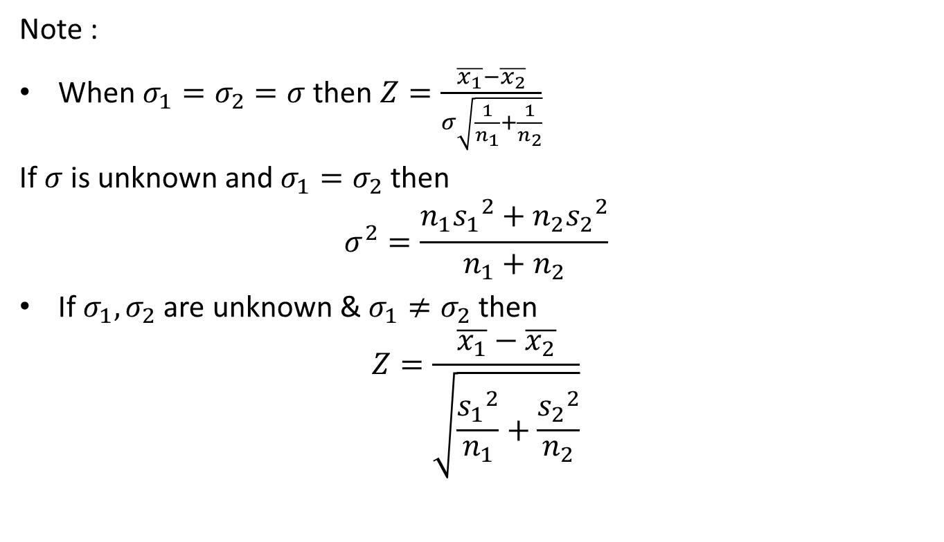
Test of Hypothesis (CO4)
Note :
When $σ_{1}=σ_{2}=σ$then $Z=\frac{\overline{x_{1}}−\overline{x_{2}}}{σ\sqrt{\frac{1}{n_{1}}+\frac{1}{n_{2}}}}$
If $σ$ is unknown and $σ_{1}=σ_{2}$ then
$$σ^{2}=\frac{n_{1}{s_{1}}_{}^{2}+n_{2}{s_{2}}_{}^{2}}{n_{1}+n_{2}}$$
If $σ_{1},σ_{2}$ are unknown & $σ_{1}≠σ_{2}$ then
$$Z=\frac{\overline{x_{1}}−\overline{x_{2}}}{\sqrt{\frac{{s_{1}}_{}^{2}}{n_{1}}+\frac{{s_{2}}_{}^{2}}{n_{2}}}}$$

Slide 35
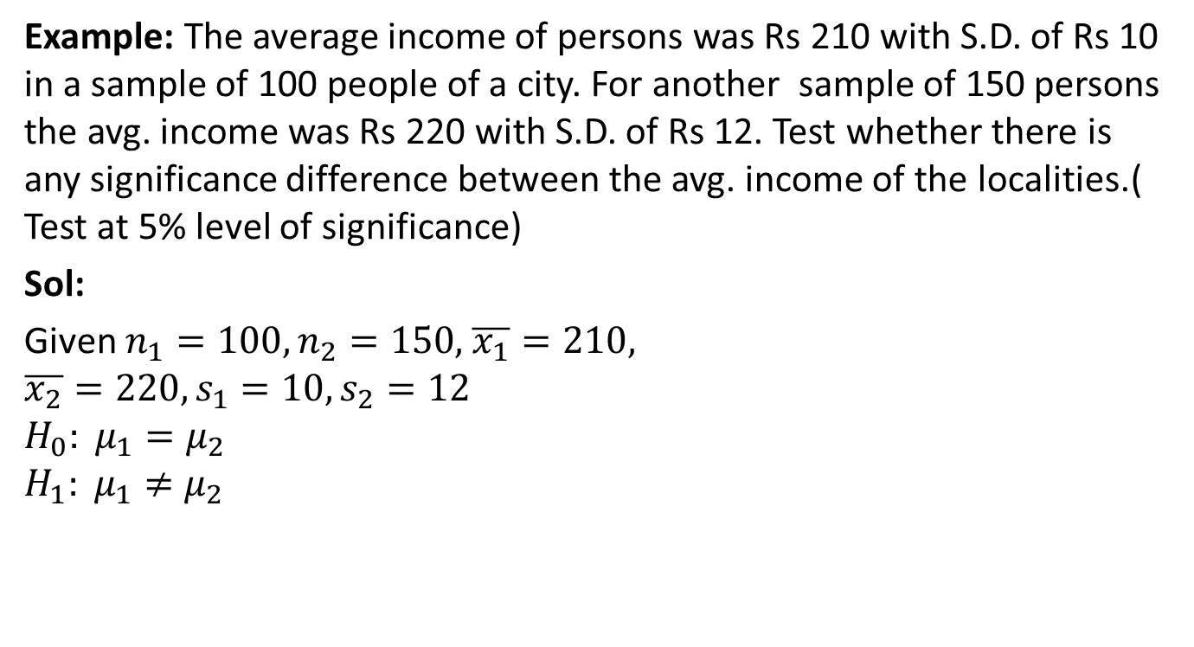
Test of Hypothesis (CO4)
Example: The average income of persons was Rs 210 with S.D. of Rs 10 in a sample of 100 people of a city. For another sample of 150 persons the avg. income was Rs 220 with S.D. of Rs 12. Test whether there is any significance difference between the avg. income of the localities.( Test at 5% level of significance)
Sol:
Given $n_{1}=100,n_{2}=150,$ $\overline{x_{1}}=210,$
$$\overline{x_{2}}=220, s_{1}=10,s_{2}=12$$
$$H_{0}: μ_{1}=μ_{2}$$
$$H_{1}: μ_{1}≠μ_{2}$$

Slide 36
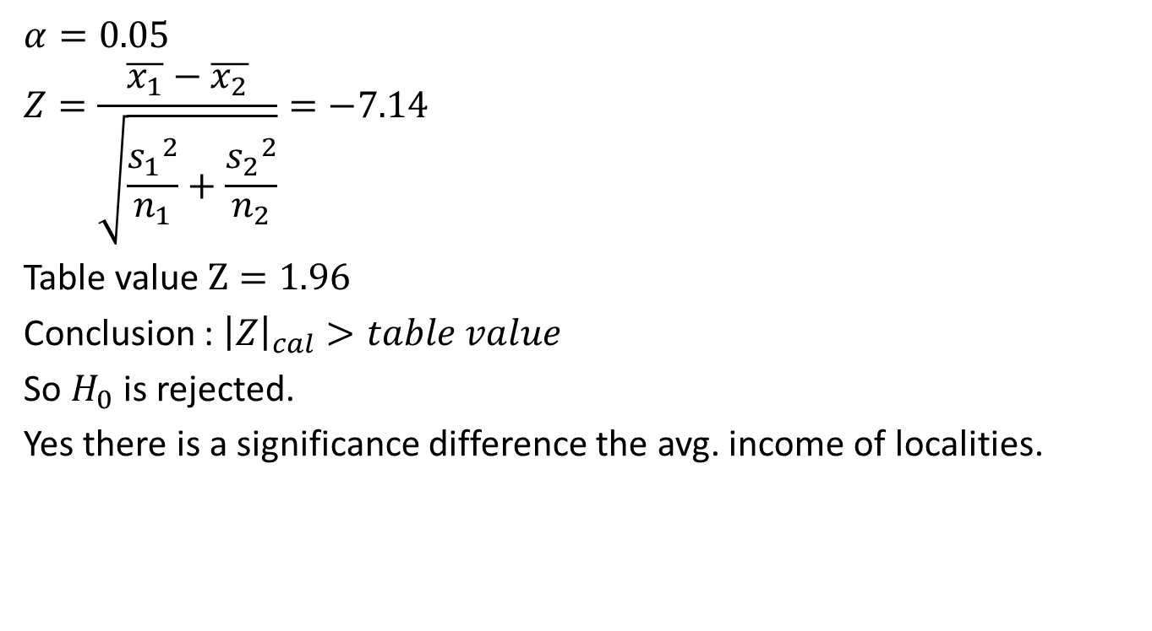
Test of Hypothesis (CO4)
$$α=0.05$$
$$Z=\frac{\overline{x_{1}}−\overline{x_{2}}}{\sqrt{\frac{{s_{1}}_{}^{2}}{n_{1}}+\frac{{s_{2}}_{}^{2}}{n_{2}}}}=−7.14$$
Table value $Z=1.96$
Conclusion : ${\left|Z\right|}_{cal}>table value$
So $H_{0}$ is rejected.
Yes there is a significance difference the avg. income of localities.

Slide 37
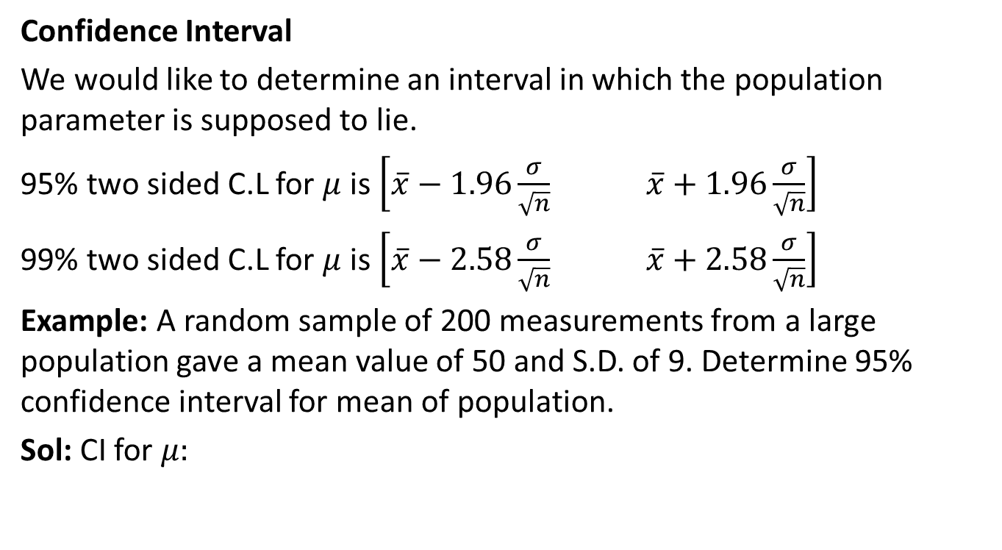
Test of Hypothesis (CO4)
Confidence Interval
We would like to determine an interval in which the population parameter is supposed to lie.
95% two sided C.L for $μ$is $\left[\overline{x}−1.96\frac{σ}{\sqrt{n}} \overline{x}+1.96\frac{σ}{\sqrt{n}}\right]$
99% two sided C.L for $μ$is $\left[\overline{x}−2.58\frac{σ}{\sqrt{n}} \overline{x}+2.58\frac{σ}{\sqrt{n}}\right]$
Example: A random sample of 200 measurements from a large population gave a mean value of 50 and S.D. of 9. Determine 95% confidence interval for mean of population.
Sol: CI for $μ:$

Slide 38
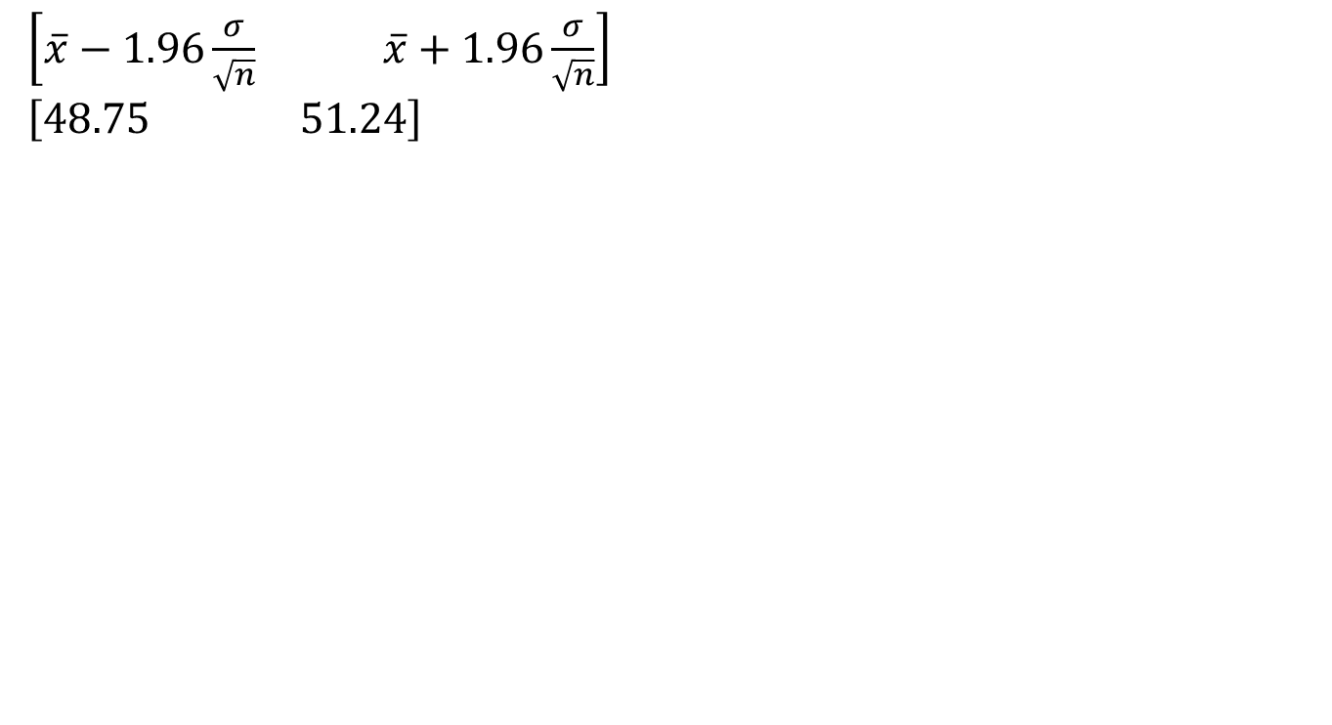
Test of Hypothesis (CO4)
$\left[\overline{x}−1.96\frac{σ}{\sqrt{n}} \overline{x}+1.96\frac{σ}{\sqrt{n}}\right]$
$$\left[48.75 51.24\right]$$

Slide 39
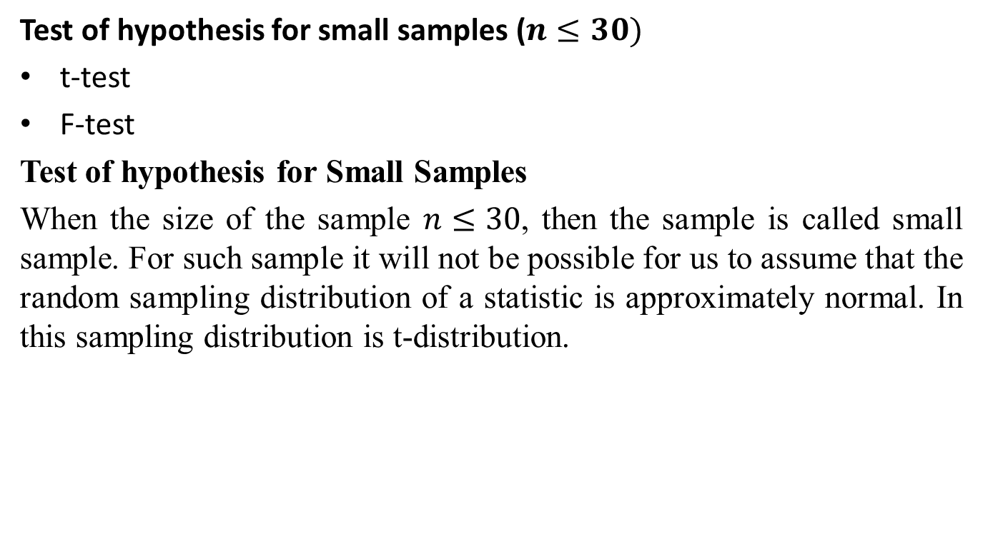
Test of Hypothesis (CO4)
Test of hypothesis for small samples ($n≤30)$
t-test
F-test
Test of hypothesis for Small Samples
When the size of the sample $n≤30$, then the sample is called small sample. For such sample it will not be possible for us to assume that the random sampling distribution of a statistic is approximately normal. In this sampling distribution is t-distribution.

Slide 40
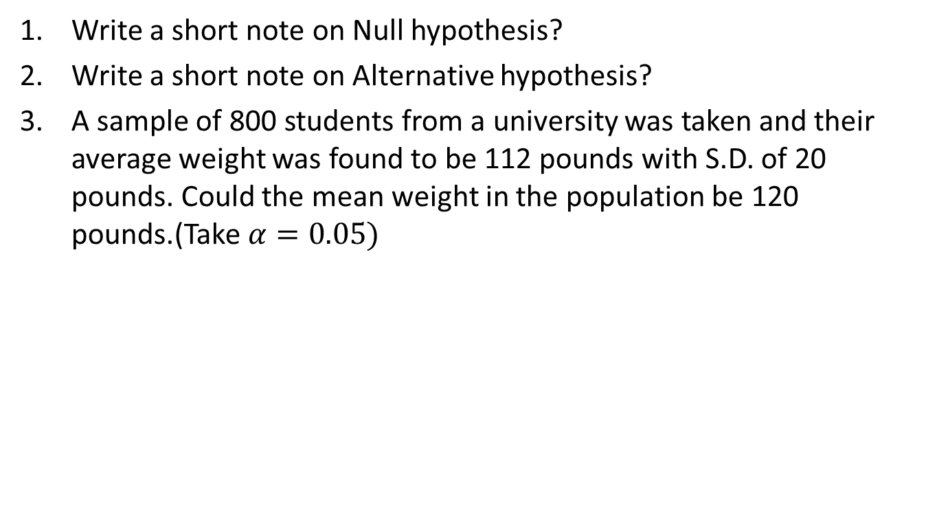
Daily Quiz(CO4)
Write a short note on Null hypothesis?
Write a short note on Alternative hypothesis?
A sample of 800 students from a university was taken and their average weight was found to be 112 pounds with S.D. of 20 pounds. Could the mean weight in the population be 120 pounds.(Take $α=0.05)$

Slide 41
Recap(CO4)
Test of hypothesis
Procedure of Test of hypothesis
Null Hypothesis
Alternate Hypothesis
Level of significance
Test of hypothesis about difference between two population mean
Test of hypothesis about Small samples

Slide 42
Topic objective (CO4)
t-Test
Explanation why a t distribution is associated with n − 1 degrees of freedom and describe the information that is conveyed by the t statistic.
Calculation the degrees of freedom for a one-sample t test and a two-independent-sample t test, and locate critical values in the t table.
Identify the assumptions for the one-sample t test.
Identify the assumptions for the two-independent-sample t test.

Slide 43
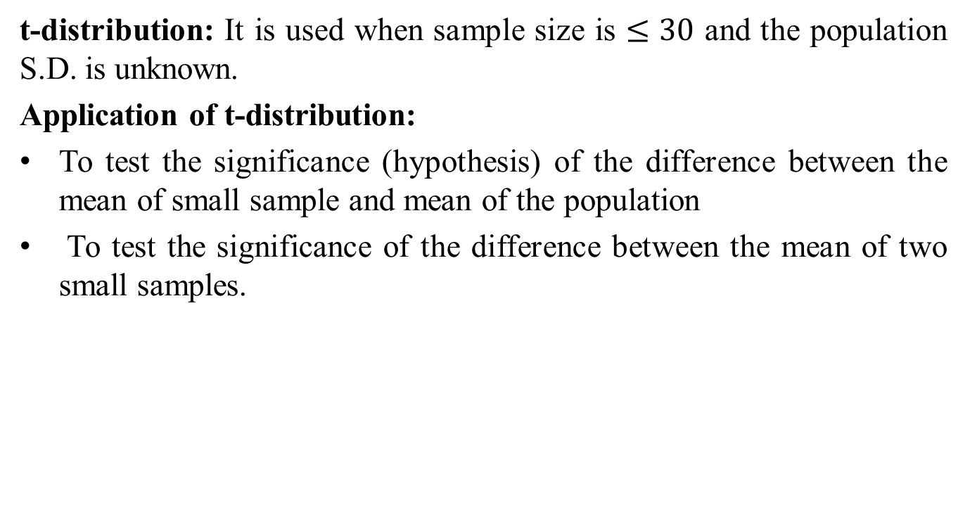
t-Test (CO4)
t-distribution: It is used when sample size is $≤30$ and the population S.D. is unknown.
Application of t-distribution:
To test the significance (hypothesis) of the difference between the mean of small sample and mean of the population
To test the significance of the difference between the mean of two small samples.

Slide 44
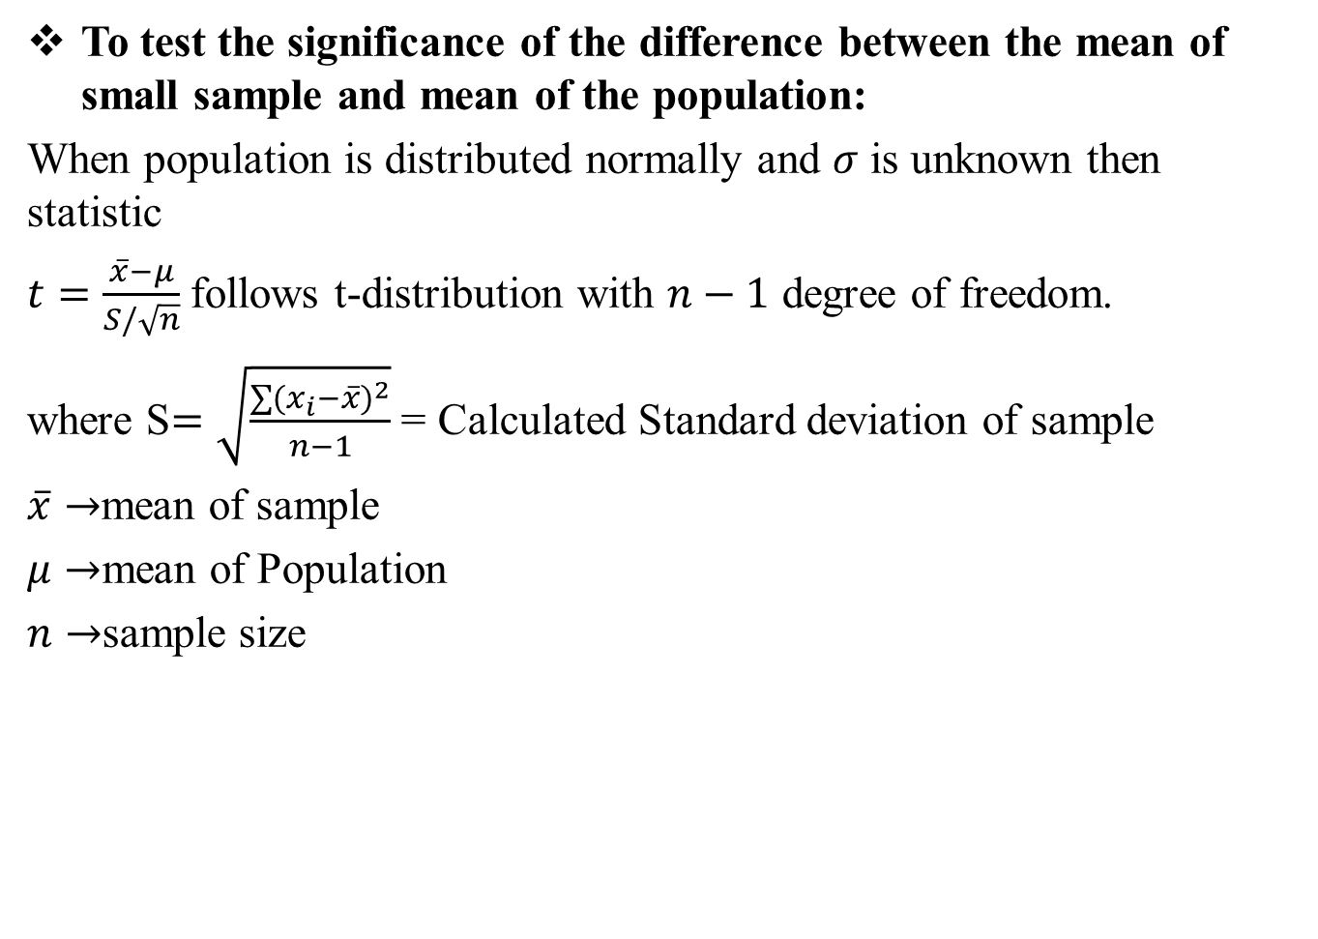
t-Test (CO4)
To test the significance of the difference between the mean of small sample and mean of the population:
When population is distributed normally and $σ$ is unknown then statistic
$t=\frac{\overline{x}−μ}{S/\sqrt{n}}$ follows t-distribution with $n−1$ degree of freedom.
where S$=\sqrt{\frac{\sum{{(x_{i}−\overline{x})}^{2}}}{n−1}}$ = Calculated Standard deviation of sample
$\overline{x}→$mean of sample
$μ→$mean of Population
$n→$sample size

Slide 45
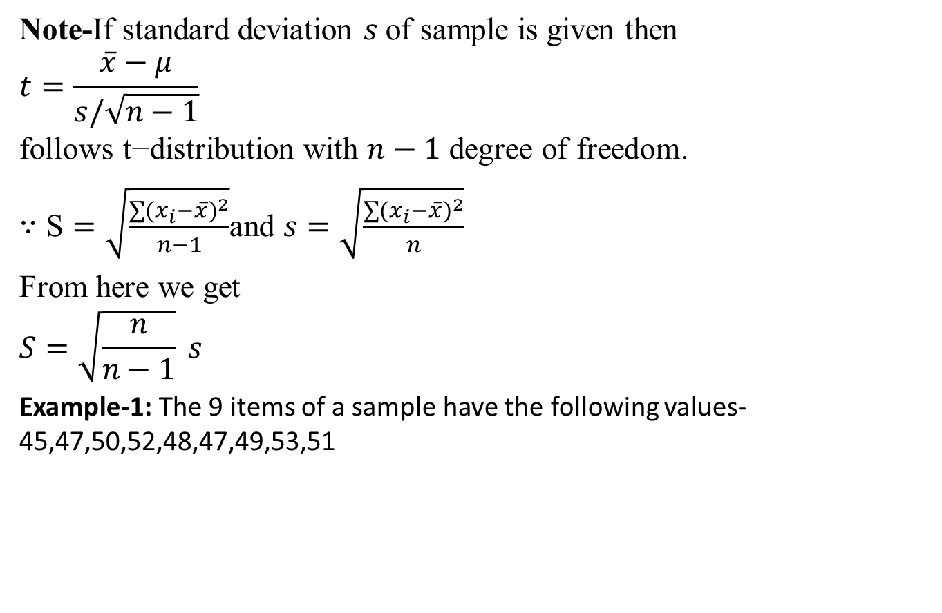
t-Test (CO4)
Note-If standard deviation $s$of sample is given then
$$t=\frac{\overline{x}−μ}{s/\sqrt{n−1}}$$
$$\text{follows} \text{t}\text{−}\text{distribution} \text{with} n−1 \text{degree} \text{of} \text{freedom}\text{.}$$
$∵\text{S}=\sqrt{\frac{\sum{{(x_{i}−\overline{x})}^{2}}}{n−1}}$and $s=\sqrt{\frac{\sum{{(x_{i}−\overline{x})}^{2}}}{n}}$
From here we get
$$S=\sqrt{\frac{n}{n−1}} s$$
Example-1: The 9 items of a sample have the following values-45,47,50,52,48,47,49,53,51

Slide 46
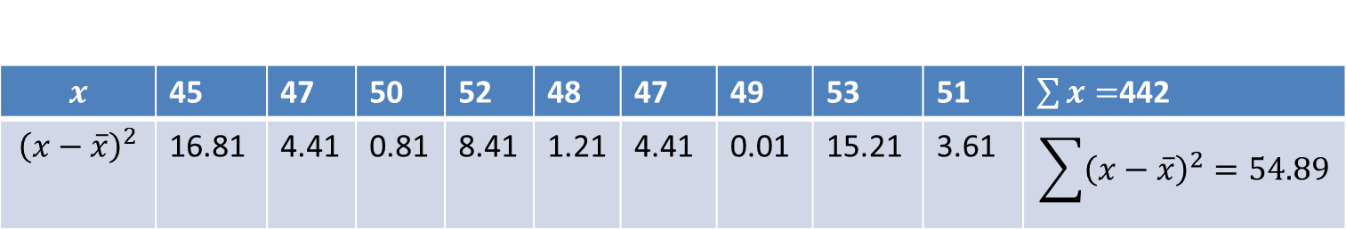
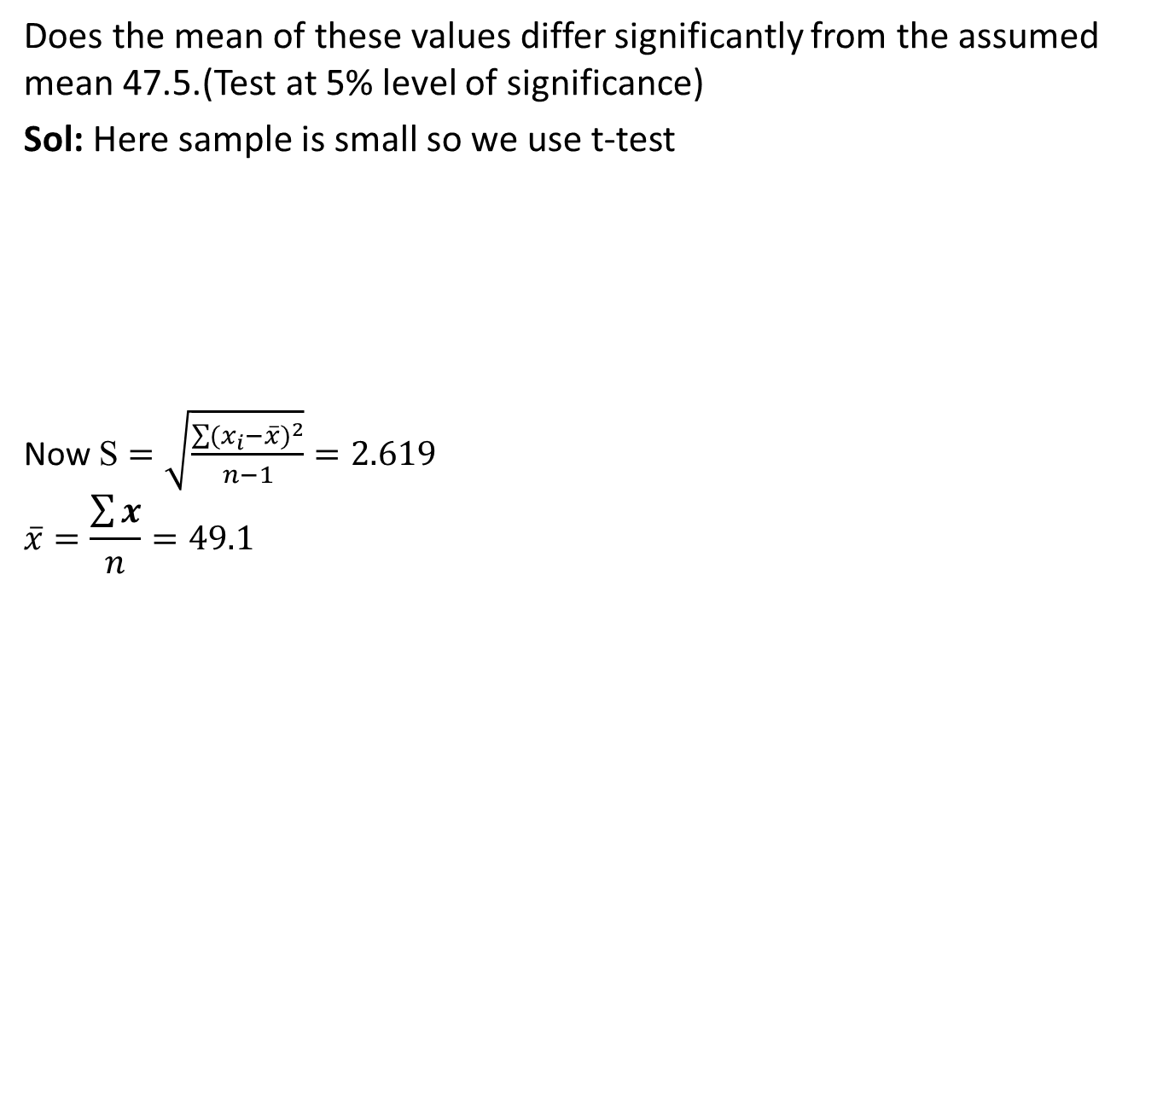
t-Test (CO4)
Does the mean of these values differ significantly from the assumed mean 47.5.(Test at 5% level of significance)
Sol: Here sample is small so we use t-test
Now $\text{S}=\sqrt{\frac{\sum{{(x_{i}−\overline{x})}^{2}}}{n−1}}=2.619$
$$\overline{x}=\frac{\sum{x}}{n}=49.1$$

Slide 47
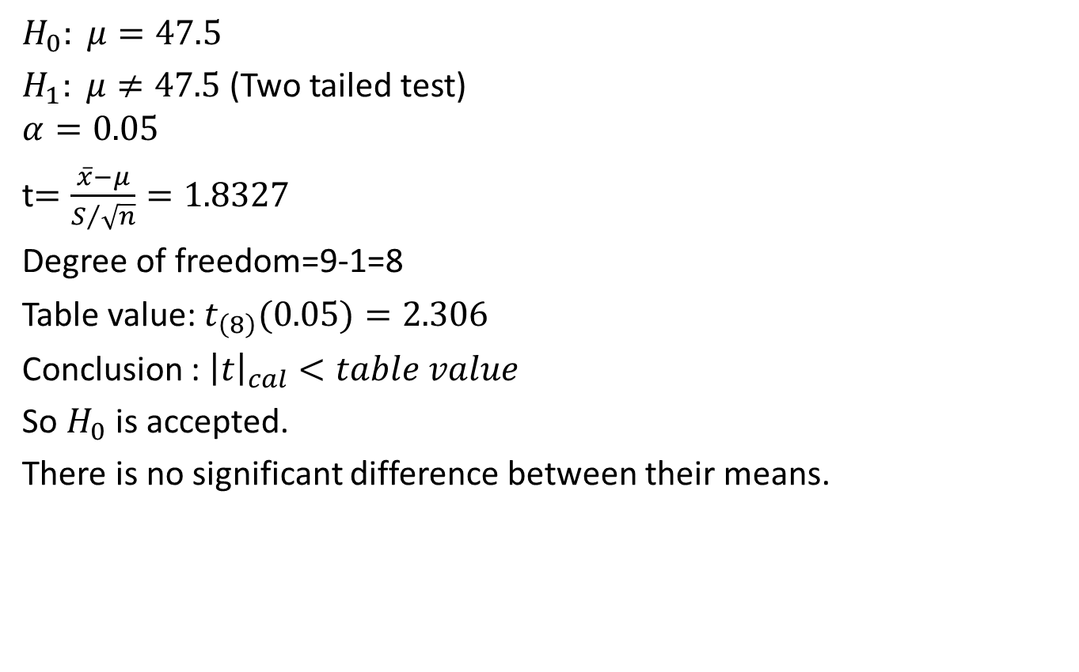
t-Test (CO4)
$$H_{0}: μ=47.5$$
$H_{1}: μ≠47.5$(Two tailed test)
$$α=0.05$$
t$=\frac{\overline{x}−μ}{S/{\sqrt{n}}}=1.8327$
Degree of freedom=9-1=8
Table value: $t_{\left(8\right)}(0.05)=2.306$
Conclusion : ${\left|t\right|}_{cal}<table value$
So $H_{0}$ is accepted.
There is no significant difference between their means.

Slide 48
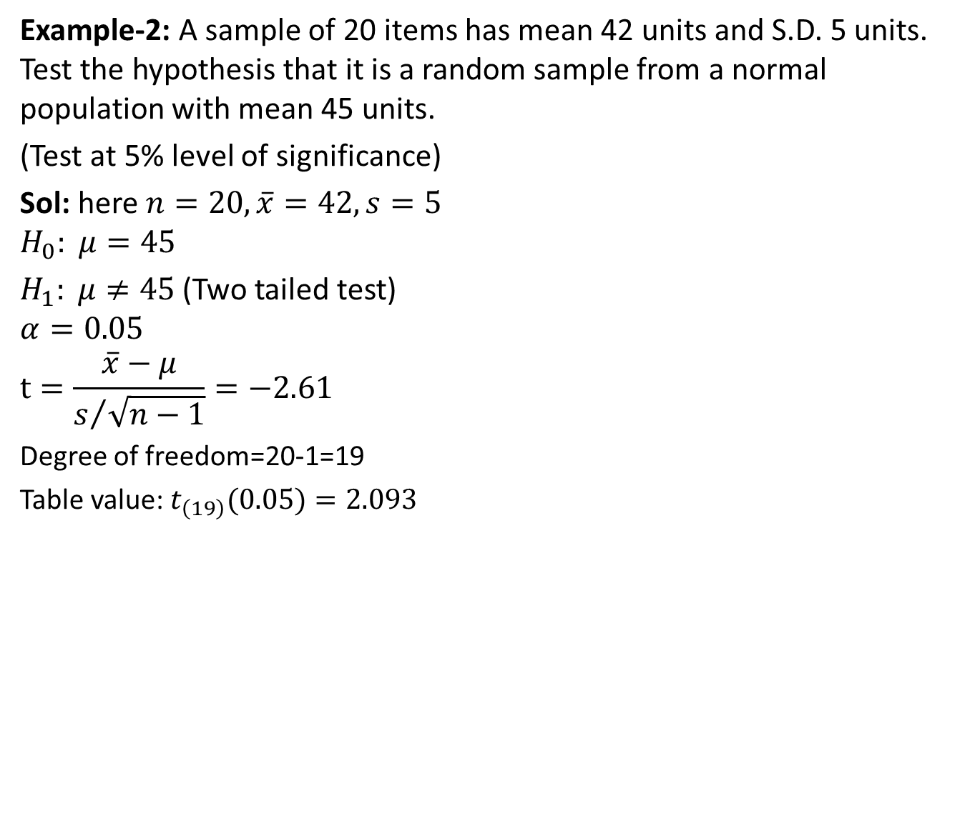
t-Test (CO4)
Example-2: A sample of 20 items has mean 42 units and S.D. 5 units. Test the hypothesis that it is a random sample from a normal population with mean 45 units.
(Test at 5% level of significance)
Sol: here $n=20, \overline{x}=42, s=5$
$$H_{0}: μ=45$$
$H_{1}: μ≠45$(Two tailed test)
$$α=0.05$$
$$t=\frac{\overline{x}−μ}{s/{\sqrt{n−1}}}=−2.61$$
Degree of freedom=20-1=19
Table value: $t_{\left(19\right)}(0.05)=2.093$

Slide 49
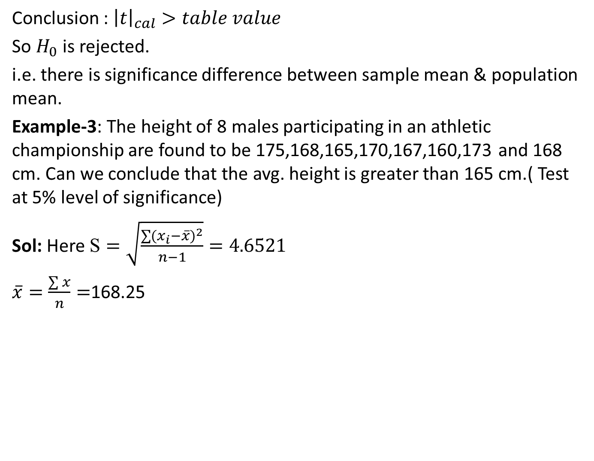
t-Test (CO4)
Conclusion : ${\left|t\right|}_{cal}>table value$
So $H_{0}$ is rejected.
i.e. there is significance difference between sample mean & population mean.
Example-3: The height of 8 males participating in an athletic championship are found to be 175,168,165,170,167,160,173 and 168 cm. Can we conclude that the avg. height is greater than 165 cm.( Test at 5% level of significance)
Sol: Here $\text{S}=\sqrt{\frac{\sum{{(x_{i}−\overline{x})}^{2}}}{n−1}}=4.6521$
$\overline{x}=\frac{\sum{x}}{n}=$168.25

Slide 50
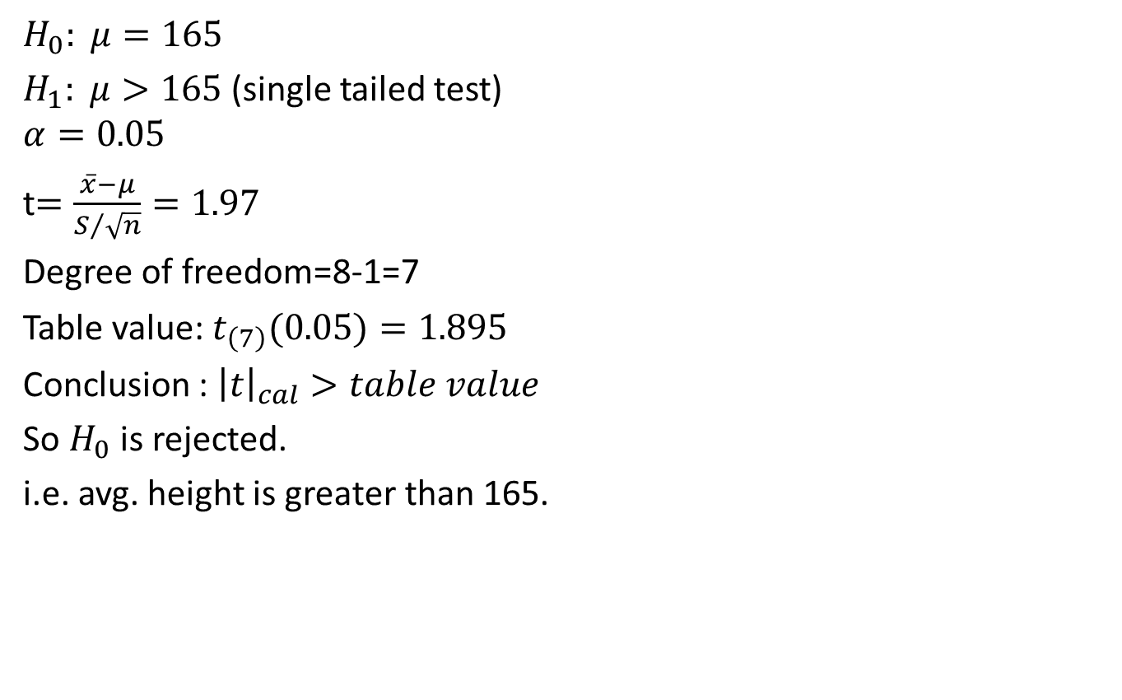
t-Test (CO4)
$$H_{0}: μ=165$$
$H_{1}: μ>165$(single tailed test)
$$α=0.05$$
t$=\frac{\overline{x}−μ}{S/{\sqrt{n}}}=1.97$
Degree of freedom=8-1=7
Table value: $t_{\left(7\right)}(0.05)=1.895$
Conclusion : ${\left|t\right|}_{cal}>table value$
So $H_{0}$ is rejected.
i.e. avg. height is greater than 165.

Slide 51
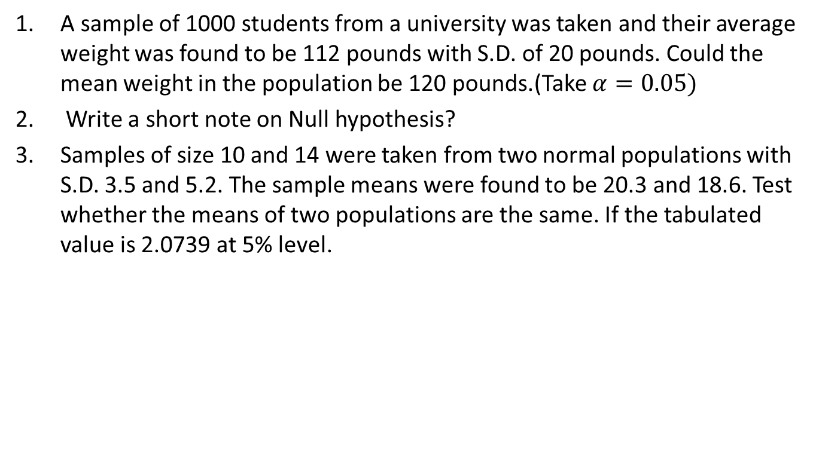
Daily Quiz(CO4)
A sample of 1000 students from a university was taken and their average weight was found to be 112 pounds with S.D. of 20 pounds. Could the mean weight in the population be 120 pounds.(Take $α=0.05)$
Write a short note on Null hypothesis?
Samples of size 10 and 14 were taken from two normal populations with S.D. 3.5 and 5.2. The sample means were found to be 20.3 and 18.6. Test whether the means of two populations are the same. If the tabulated value is 2.0739 at 5% level.

Slide 52
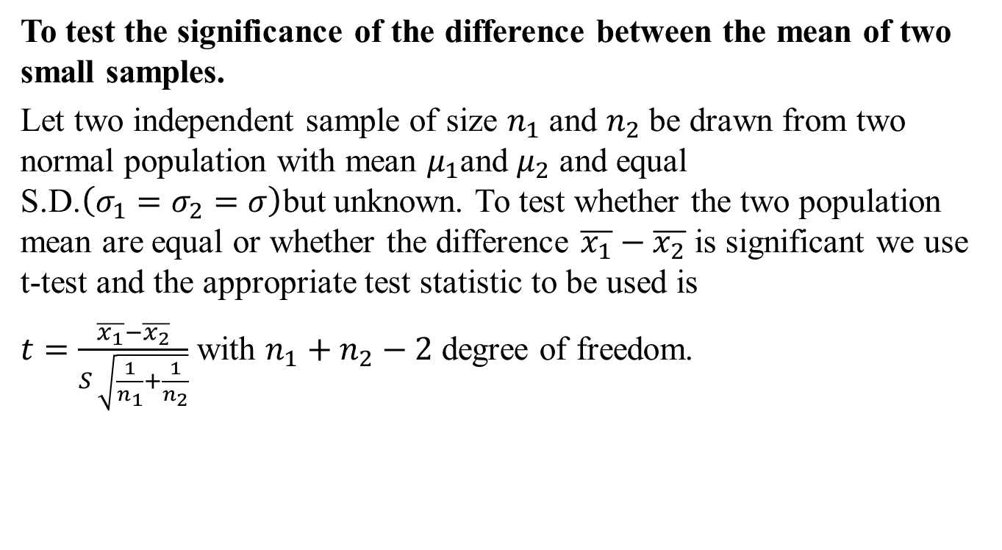
t-Test (CO4)
To test the significance of the difference between the mean of two small samples.
Let two independent sample of size $n_{1}$ and $n_{2}$ be drawn from two normal population with mean $μ_{1}$and $μ_{2}$ and equal S.D.$\left(σ_{1}=σ_{2}=σ\right)$but unknown. To test whether the two population mean are equal or whether the difference $\overline{x_{1}}−\overline{x_{2}}$ is significant we use t-test and the appropriate test statistic to be used is
$t=\frac{\overline{x_{1}}−\overline{x_{2}}}{S \sqrt{\frac{1}{n_{1}}+\frac{1}{n_{2}}}}$ with $n_{1}+n_{2}−2$ degree of freedom.

Slide 53
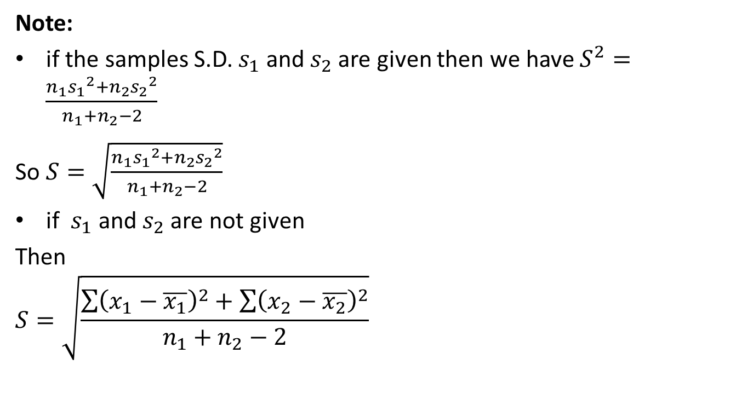
t-Test (CO4)
Note:
if the samples S.D. $s_{1}$ and $s_{2}$ are given then we have $S^{2}=\frac{n_{1}{s_{1}}_{}^{2}+n_{2}{s_{2}}_{}^{2}}{n_{1}+n_{2}−2}$
So $S=\sqrt{\frac{n_{1}{s_{1}}_{}^{2}+n_{2}{s_{2}}_{}^{2}}{n_{1}+n_{2}−2}}$
if $s_{1}$ and $s_{2}$ are not given
Then
$$S=\sqrt{\frac{\sum{{\left(x_{1}−\overline{x_{1}}\right)}^{2}}+\sum{{\left(x_{2}−\overline{x_{2}}\right)}^{2}}}{n_{1}+n_{2}−2}}$$

Slide 54
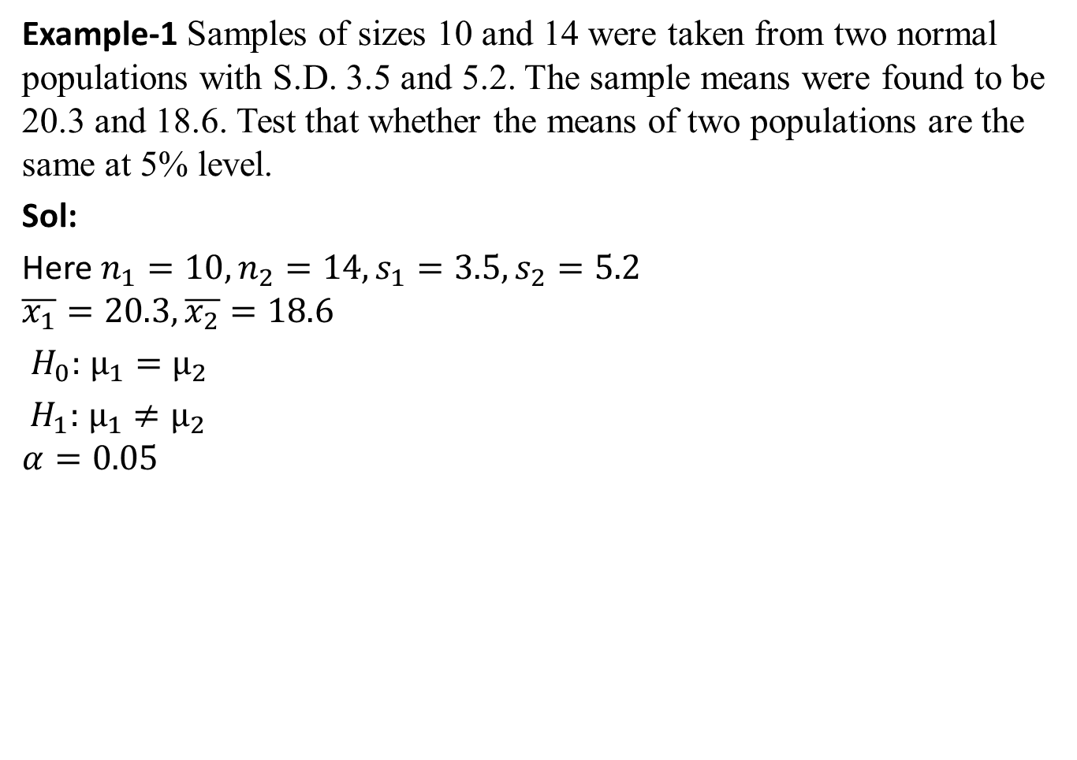
t-Test (CO4)
Example-1 Samples of sizes 10 and 14 were taken from two normal populations with S.D. 3.5 and 5.2. The sample means were found to be 20.3 and 18.6. Test that whether the means of two populations are the same at 5% level.
Sol:
Here $n_{1}=10,n_{2}=14,s_{1}=3.5,s_{2}=5.2$
$$\overline{x_{1}}=20.3,\overline{x_{2}}=18.6$$
$H_{0}:$ $μ_{1}=μ_{2}$
$H_{1}:$ $μ_{1}≠μ_{2}$
$$α=0.05$$

Slide 55
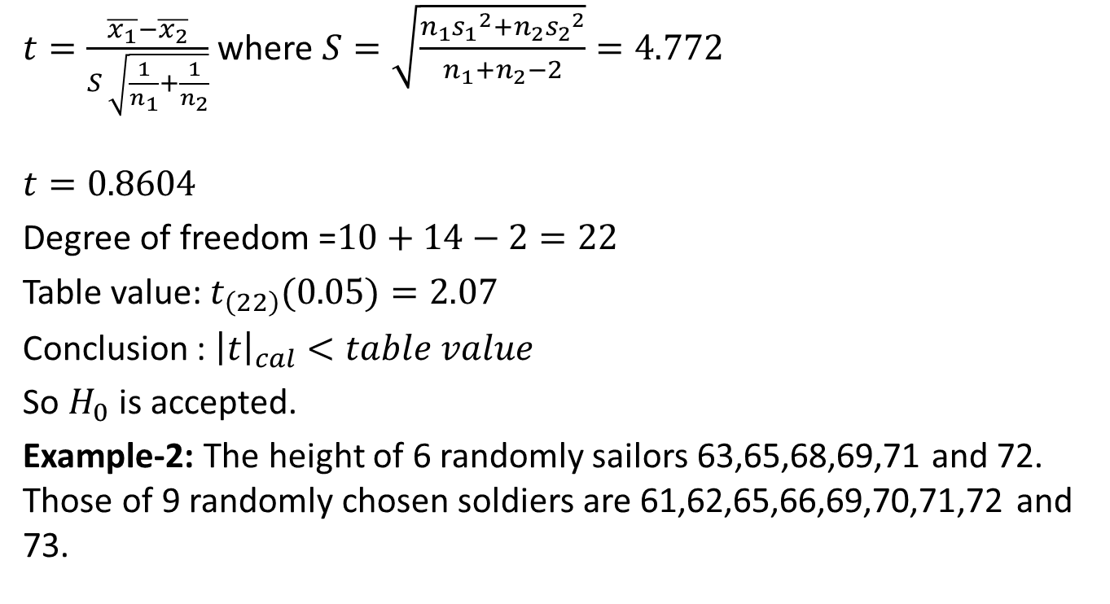
t-Test (CO4)
$t=\frac{\overline{x_{1}}−\overline{x_{2}}}{S \sqrt{\frac{1}{n_{1}}+\frac{1}{n_{2}}}}$ where $S=\sqrt{\frac{n_{1}{s_{1}}_{}^{2}+n_{2}{s_{2}}_{}^{2}}{n_{1}+n_{2}−2}}=4.772$
$$t=0.8604$$
Degree of freedom =$10+14−2=22$
Table value: $t_{\left(22\right)}(0.05)=2.07$
Conclusion : ${\left|t\right|}_{cal}<table value$
So $H_{0}$ is accepted.
Example-2: The height of 6 randomly sailors 63,65,68,69,71 and 72. Those of 9 randomly chosen soldiers are 61,62,65,66,69,70,71,72 and 73.

Slide 56
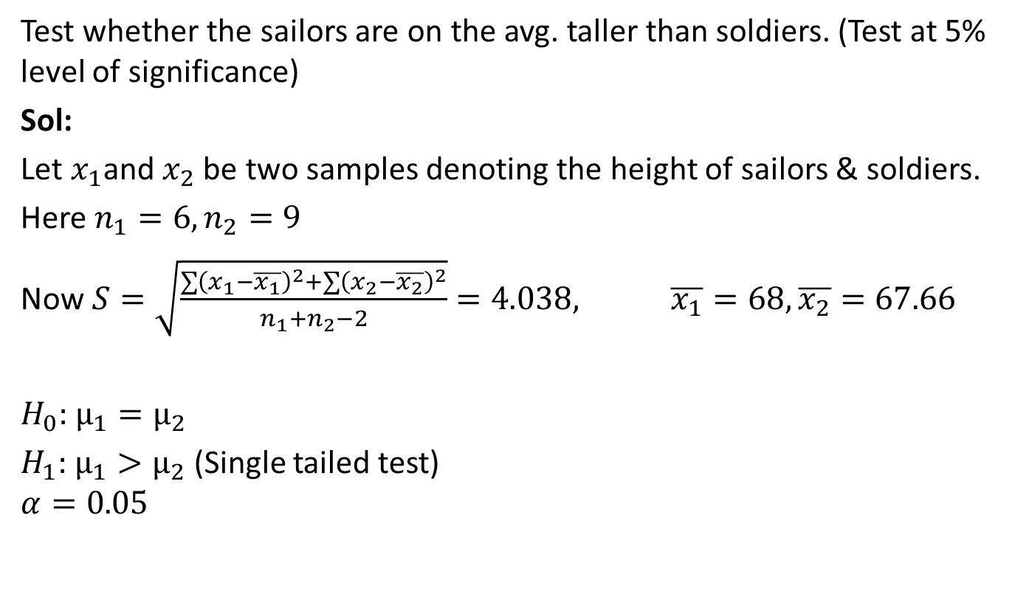
t-Test (CO4)
Test whether the sailors are on the avg. taller than soldiers. (Test at 5% level of significance)
Sol:
Let $x_{1}$and $x_{2}$ be two samples denoting the height of sailors & soldiers.
Here $n_{1}=6,n_{2}=9$
Now $S=\sqrt{\frac{\sum{{\left(x_{1}−\overline{x_{1}}\right)}^{2}}+\sum{{\left(x_{2}−\overline{x_{2}}\right)}^{2}}}{n_{1}+n_{2}−2}}=4.038, \overline{x_{1}}=68,\overline{x_{2}}=67.66$
$H_{0}:$ $μ_{1}=μ_{2}$
$H_{1}:$ $μ_{1}>μ_{2}$ (Single tailed test)
$$α=0.05$$

Slide 57
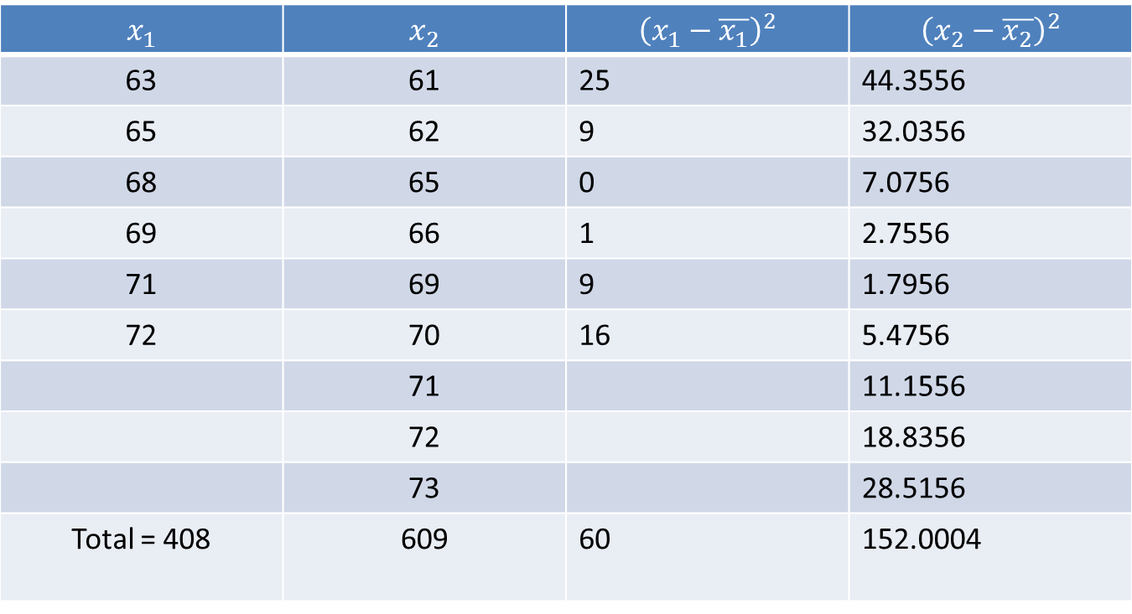
t-Test (CO4)
a

Slide 58
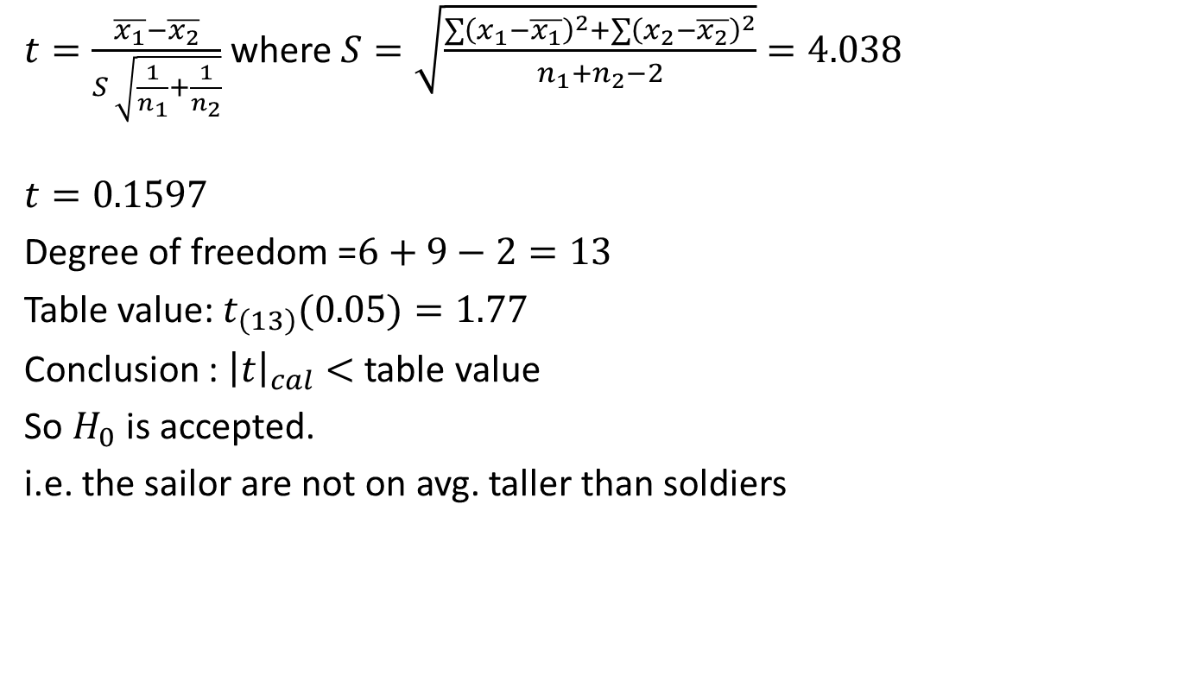
t-Test (CO4)
$t=\frac{\overline{x_{1}}−\overline{x_{2}}}{S \sqrt{\frac{1}{n_{1}}+\frac{1}{n_{2}}}}$ where$S=\sqrt{\frac{\sum{{\left(x_{1}−\overline{x_{1}}\right)}^{2}}+\sum{{\left(x_{2}−\overline{x_{2}}\right)}^{2}}}{n_{1}+n_{2}−2}}=4.038$
$$t=0.1597$$
Degree of freedom =$6+9−2=13$
Table value: $t_{\left(13\right)}(0.05)=1.77$
Conclusion : ${\left|t\right|}_{cal}<$ table value
So $H_{0}$ is accepted.
i.e. the sailor are not on avg. taller than soldiers

Slide 59
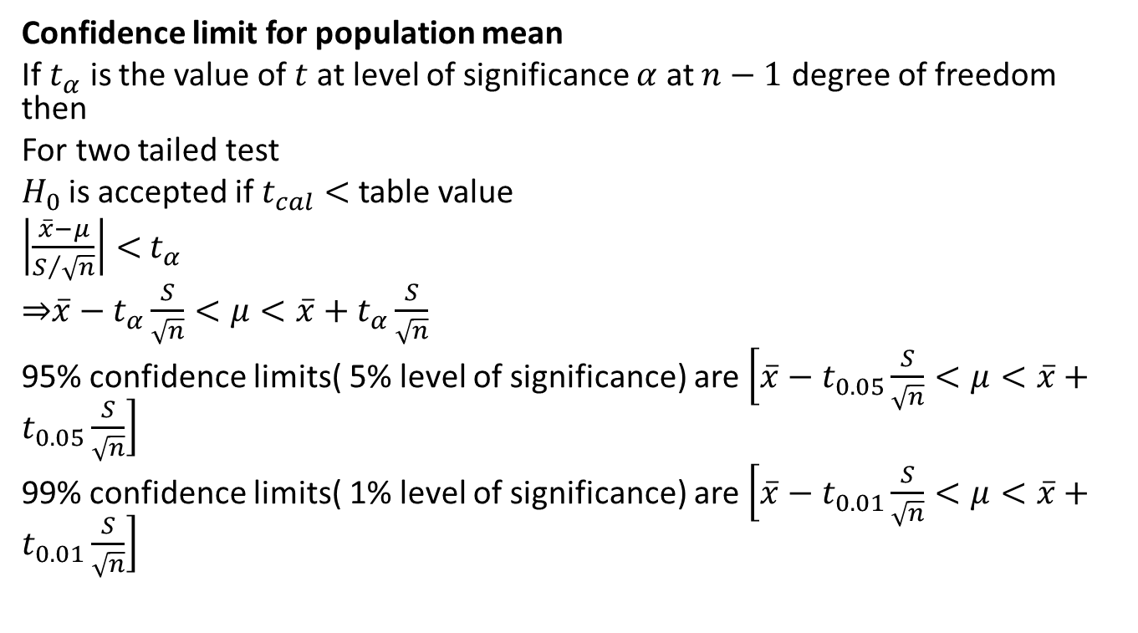
t-Test (CO4)
Confidence limit for population mean
If $t_{α}$ is the value of $t$ at level of significance $α$ at $n−1$ degree of freedom then
For two tailed test
$H_{0}$is accepted if $t_{cal}<$table value
$\left|\frac{\overline{x}−μ}{S/{\sqrt{n}}}\right|<$ $t_{α}$
⇒$\overline{x}−t_{α}\frac{S}{\sqrt{n}}<μ<\overline{x}+t_{α}\frac{S}{\sqrt{n}}$
95% confidence limits( 5% level of significance) are $\left[\overline{x}−t_{0.05}\frac{S}{\sqrt{n}}<μ<\overline{x}+t_{0.05}\frac{S}{\sqrt{n}}\right]$
99% confidence limits( 1% level of significance) are $\left[\overline{x}−t_{0.01}\frac{S}{\sqrt{n}}<μ<\overline{x}+t_{0.01}\frac{S}{\sqrt{n}}\right]$

Slide 60
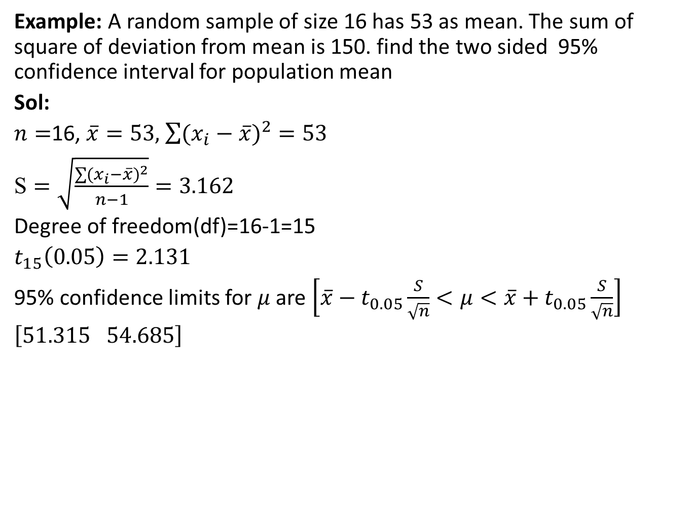
t-Test (CO4)
Example: A random sample of size 16 has 53 as mean. The sum of square of deviation from mean is 150. find the two sided 95% confidence interval for population mean
Sol:
$n=$16, $\overline{x}=53,$ $\sum{{(x_{i}−\overline{x})}^{2}}=53$
$\text{S}=\sqrt{\frac{\sum{{(x_{i}−\overline{x})}^{2}}}{n−1}}=3.162$
Degree of freedom(df)=16-1=15
$t_{15}\left(0.05\right)=2.131$
95% confidence limits for $μ$ are $\left[\overline{x}−t_{0.05}\frac{S}{\sqrt{n}}<μ<\overline{x}+t_{0.05}\frac{S}{\sqrt{n}}\right]$
$\left[51.315 54.685\right]$

Slide 61

Daily Quiz(CO4)
Problem: Intelligent test were given to two groups of boys & girls
Mean S.D. Size
Girl 75 8 60
Boys 73 10 100
Examine if the difference between mean scores is significant? (Take $α=0.05)$
Ans: $H_{0}$ is accepted

Slide 62

Weekly Assignment(CO4)
1 Intelligent test were given to two groups of boys & girls
Mean S.D. Size
Girl 68 5 60
Boys 85 10 100
Examine if the difference between mean scores is significant? (Take $α=0.05)$
2. Define Null hypothesis for
t test
Z-test

Slide 63
Recap(CO4)
Test of hypothesis
Procedure of Test of hypothesis
Null Hypothesis
Alternate Hypothesis
Level of significance
Test of hypothesis about difference between two population mean
t-Test

Slide 64

Topic Objective (CO4)
Chi Square Test($χ^{2}$)
Distinguish between nonparametric and parametric tests.
Explanation how the test statistic is computed for a chi-square test.
Compute the chi-square goodness-of-fit test and interpret the results.
Identify the assumption and the restriction of expected frequency size for the chi-square test.
Compute the chi-square test for independence and interpret the results.

Slide 65


Chi Square Test($χ^{2}$)(CO4)
Chi Square Test($χ^{2}$)
Chi-square test of goodness of Fit.
Chi-square test of independence of Attributes.

Slide 66

Chi Square Test($χ^{2}$)(CO4)
Chi Square Test($χ^{2}$)
Chi Square test is the test of significance.
Chi square test is a useful measures of comparing experimentally obtained result with those expected theoretically and based on hypothesis.
$χ^{2}=\sum{\frac{{\left(Observed−Expected\right)}^{2}}{Expected}}$
It is a mathematical expression, representing the ratio of experimentally obtained result(O) and theoretically expected result(E) based on certain hypothesis. It uses data in form of frequencies.

Slide 67

Chi Square Test($χ^{2}$)(CO4)
Chi square test is calculated by dividing the square of overall deviation in the observed and expected frequencies by expected frequency. $χ^{2}=\sum{\frac{{\left(O−E\right)}^{2}}{E}}$
O=the frequencies observed, E=the frequencies expected$,Σ$= sum of
If there is no difference between actual and observed frequencies, the value of Chi- Square is zero.
If there is difference between actual and observed frequencies, the value of Chi- Square would be more than zero.
But the difference in the observed frequencies, may also be due to the sampling fluctuations and it should be ignored in drawing interference.

Slide 68
Chi Square Test($χ^{2}$)(CO4)
Degree of Freedom
In test, while comparing the calculated value with the table value, we have to calculate the degree of freedom. The degree of freedom is calculated from the no of classes. Therefore, the no. of degree of freedom in a test is equal to the no. of classes minus one.
If there are two classes, three classes and four classes, the degree of freedom would be 2-1,3-1 and 4-1, respectively. In a contingency table, the degree of freedom is calculated in different manner:
d.f.=(r-1)(c-1)
Where r= no. of row in the table,C= no. of column in the table
Thus in 2×2 contingency table, the degree of freedom is (2-1)(2-1)=1. Similarly, in a 3×3 contingency table, the degree of freedom is

Slide 69

Chi Square Test($χ^{2}$)(CO4)
(3-1)(3-1)=4. :Likewise in 3×4 contingency table degree of freedom is (3-1)(4-1)=6, and so on.
Example:2 Rows × 2 columns
Degree of freedom = (r-1)(c-1)=(2-1)(2-1)=1

Slide 70
Chi Square Test($χ^{2}$)(CO4)
Application of chi square test
The chi square are applicable in varied problems in agriculture, biology engineering and medical sciences.
To test the goodness of fit.
To test the independence of attributes.
To test the detection of linkage.
To test the homogeneity of independent estimates of the population variance.

Slide 71

Chi Square Test($χ^{2}$)(CO4)
Example: The demand for a particular spare part in a factory was found to vary from day-to-day. In a sample study the following information was obtained:
Under the null hypothesis, the expected frequencies of the spare part demanded on each of the six days would be:(1124+1125+1110+1120+1126+1115)/6=6270/6=1120

Slide 72

Chi Square Test($χ^{2}$)(CO4)

Slide 73

Chi Square Test($χ^{2}$)(CO4)
$χ^{2}=\sum_{i=1}^{n}{\frac{{\left(Observed−Expected\right)}^{2}}{Expected}}$=0.179
The number of degrees of freedom = 6 –1 = 5 (since we are given 6 frequencies subjected to only one linear constraint: ∑$O_{i}$=∑$E_{i}$=6720). The tabulated ${χ^{2}}_{0.05}^{}$for 5 d.f.= 11.07
Conclusion: Since calculated value of $χ^{2}$is less than the tabulated value, it is not significant and the null hypothesis may accepted at 5% level of significance. Hence we conclude that the numbers of parts demanded are same over the 6-day period.

Slide 74

Chi Square Test($χ^{2}$)(CO4)
Chi square test of Independent of Attributes:
Let us consider two attributes A and B divides into r classes $A_{1,}A_{2},A_{3}…A_{r}$and B divided into s classes $B_{1,}B_{2},B_{3}…B_{s}.$
Such a classification in which attributes are divided into more than two classes is known as manifold classification.
$$χ^{2}=\sum_{i=1}^{r}{\sum_{j=1}^{s}{\frac{[{\left(A_{i}B_{j}\right)−{\left(A_{i}B_{j}\right)}_{o}^{}]}^{2}}{{\left(A_{i}B_{j}\right)}_{o}^{}}}\text{=}}\sum_{i=1}^{r}{\sum_{j=1}^{s}{\frac{[{O_{ij}−E_{ij}]}^{2}}{E_{ij}}}}$$

Slide 75

Chi Square Test($χ^{2}$)(CO4)
Where $O_{ij}$=$A_{i}B_{j}$: observed frequency for contingency table category in column i and row j.
$E_{ij}$=${\left(A_{i}B_{j}\right)}_{o}^{}$: expected frequency for contingency table category in column i and row j.
${\left(A_{i}B_{j}\right)}_{o}^{}$=$\frac{{(A)}_{i}{(B)}_{j}}{N}$, (i=1,2,3…r,j=1,2,3…s)
Which is distributed as a $χ^{2}$with (r-1)(s-1)d.f.
Example :Two sample polls of votes for two candidates A and B for public office are taken, one from among the resident area of ruler areas. The results are given in the following table. Examine whether the nature of area related to the voting preference in elections.

Slide 76


Chi Square Test($χ^{2}$)(CO4)
Solution : $H_{0}:$ the nature of the area is independent of the voting preference in the election
Expected frequencies
E(620)=$\frac{1170×1000}{2000}=585$
E(380)=$\frac{830×1000}{2000}=415$
E(550)=$\frac{1170×1000}{2000}=585$

Slide 77

Chi Square Test($χ^{2}$)(CO4)
E(450)=$\frac{830×1000}{2000}=415$
Calculate the statistic $χ^{2}$
=$\frac{{(620−585)}^{2}}{585}$+$\frac{{(380−415)}^{2}}{415}$+$\frac{{(550−585)}^{2}}{585}$+$\frac{{(450−415)}^{2}}{415}$
=10.0891
The tabulated ${χ^{2}}_{0.05}^{}$for (2-1)(2-1) d.f.= 3.841
Conclusion: since calculate $χ^{2}$is much greater than the tabulated value, it is highly significant and null hypothesis is rejected at 5% of level of significance. Thue we conclude that nature of area is rejected to voting preference in the election.

Slide 78


Chi Square Test($χ^{2}$)(CO4)
Example : What are the expected frequencies of the contingency tables given below:
Observed frequency:
Expected frequency:

Slide 79


Chi Square Test($χ^{2}$)(CO4)
Example :To test the effectiveness of inoculation against cholera, the following table was obtained:
( figures represent the number of persons.)
Use $χ^{2}$ test to defend or refute the statement that the inoculation prevents attack from cholera.
Solution : $H_{0}:$the inoculation does not prevents attack from cholera.

Slide 80



Chi Square Test($χ^{2}$)(CO4)
Expected frequencies
Calculate the statistic $χ^{2}$

Slide 81

Chi Square Test($χ^{2}$)(CO4)
${χ2}_{cal}^{}$= $\sum{\frac{{\left(Oi−Ei\right)}^{2}}{Ei}}$ =4.8863
The tabulated ${χ^{2}}_{0.05}^{}$for (2-1)(2-1) d.f.= 3.841
Conclusion: since calculate $χ^{2}$is much greater than the tabulated value, it is highly significant and null hypothesis is rejected at 5% of level of significance. Hence we defend the statement that inoculation prevents attack from cholera.

Slide 82
Daily Quiz(CO4)
Q1 The following figures relate to the production in kg of three varieties I, II, III of wheat shown in 12 plots:
Is there any significant difference in the production of three varieties? Given the tabulated value is 4.26 at 5% level of significance.
Variety I | 14 | 16 | 18
Variety II | 14 | 13 | 15 | 22
Variety III | 18 | 16 | 19 | 19 | 20

Slide 83

Recap(CO4)
Test of hypothesis
Test of hypothesis about difference between two population mean
To test the significance of the difference between the mean of two small samples.
$χ^{2}$ test

Slide 84
Topic objective (CO4)
Analysis of variance(ANOVA)
Appropriately interpret results of analysis of variance tests.
Distinguish between one and two factor analysis of variance tests.
Identify the appropriate hypothesis testing procedure based on type of outcome variable and number of samples.

Slide 85
Analysis of Variance (ANOVA)(CO4)
Analysis of Variance (ANOVA)
One-Way ANOVA Definition
A ANOVA is used when we have to compare more than two group means or population.
The technique is used when multiple sample cases are involved.

Slide 86
Analysis of Variance (ANOVA)(CO4)
ANOVA is to split up the total variation as follows:
Variance between samples.
Variance within samples.
ANOVA classification
One way ANOVA: This is used to see the effect of an independent variable on a given dependent variable.
Two way ANOVA: This is used to see the effect of two independent variable on a given dependent variable.

Slide 87


Analysis of Variance (ANOVA)(CO4)
ANOVA TABLE:
Computation of test statistic
F =$\frac{variance between the samples}{\text{variance} \text{within} \text{the} \text{samples} }=\frac{\text{M}\text{SC}}{\text{MSE} }$

Slide 88

Analysis of Variance (ANOVA)(CO4)
Q.1 It Is desired to compare three Hospitals with regards to number of deaths per month. A sample of death records of each hospital and the number of deaths was given below. From these data suggest a difference in the no. of the deaths per month among three hospitals.

Slide 89

Analysis of Variance (ANOVA)(CO4)
Sol.Null hypothesis $H_{0 }$:There is no difference in the no. of deaths per months among three hospitals.
Alternate hypothesis $H_{1}$:There is a significant difference in the no. of death per month among three hospitals.
Level of Significance : We use 5% level of Significance.
Test Statistic : To find the Variance ratio F, we set up an ANOVA tables as follows:
Sample totals:
∑$y_{a}=3+4+3+5+0=15$
$∑y_{b}=6+3+3+4+4=20$
$∑y_{c}=7+3+4+6+5=25$

Slide 90

Analysis of Variance (ANOVA)(CO4)
Grand total(T)=$∑y_{a}$+$∑y_{b}+∑y_{c}$=60
Correction factor(C.F)=$\frac{{\left(T\right)}^{2}}{n}$=$\frac{{60}^{2}}{15}=$240
Sum of Squares of Samples:
$∑{y^{2}}_{A}$=$3^{2}$+$4^{2}$+$3^{2}$+$5^{2}$+$0^{2}$=59
$∑{y^{2}}_{B}$=$6^{2}$+$3^{2}$+$3^{2}$+$4^{2}$+$4^{2}$=86
$∑{y^{2}}_{C}$=$7^{2}$+$3^{2}$+$4^{2}$+$6^{2}$+$5^{2}$=135
Total Sum of Squares= $∑{y^{2}}_{A}$+$∑{y^{2}}_{B}$+$∑{y^{2 }}_{C}$ - C.F
=59+86+135-240=40

Slide 91

Analysis of Variance (ANOVA)(CO4)
Sum of Squares between Samples
=$\frac{ \left(∑y_{A}\right) ^{2}}{n_{1}}+\frac{ \left(∑y_{B}\right) ^{2}}{n_{2}}+\frac{ \left(∑y_{C}\right) ^{2}}{n_{3}}−\frac{ \left(T\right) ^{2}}{n}$
=$\frac{ \left(15\right) ^{2}}{5}+\frac{ \left(20\right) ^{2}}{5}+\frac{ \left(25\right) ^{2}}{5}−240$
= 10
Sum of squares with in the samples
= Total sum of squares – sum of squares between the samples
= 40-10
=30

Slide 92

Analysis of Variance (ANOVA)(CO4)
Degree of freedom for total sum of squares =n-1=15-1=14
Degree of freedom for Hospitals=c-1 = 3-1=2
Degree of freedom for Error =n-c =15-3=12
ANOVA TABLE

Slide 93

Analysis of Variance (ANOVA)(CO4)
The tabular value of F at 5 % level of significance with degree of freedom $ν_{1}$=2 & $ν_{2}=12 is 3.89$:
Conclusion: $F_{cal}<F_{tab},$i. e. H0 is accepted, so the difference is insignificant and we conclude that the data donot suggest a difference in the no of deaths per month among the three hospitals.

Slide 94

Analysis of Variance (ANOVA)(CO4)
Q.2 A manufacturing company purchased three new machines of different makes and wishes to determine whether one of them is faster than the others in producing a certain out put . Five hourly production figures are observed at random from each machine and the results are given below:

Slide 95

Analysis of Variance (ANOVA)(CO4)
Use ANOVA and determine whether the machines are significantly
Different in their mean speed.(Given at 5% level,F2,12=3.89)
Sol. Null hypothesis H0: Machines are not significantly different in their mean speed i.e.,$μ1=μ2=μ3$.
Alternate hypothesis $H_{1}$:Machines are significantly different in their mean speed.
Level of Significance: We use 5% level of Significance.
Test Statistic: T o find the Variance ratio F, we set up an ANOVA tables as follows: let us shift the origin at 30 i.e., reduce each observations by 30.we have

Slide 96


Analysis of Variance (ANOVA)(CO4)
Sample totals:
∑$A_{1}=−5+0+6+8+1=1$0
$∑A_{2}=1+9+8+12+5=$35
$∑A_{3}=−6+0−2−5−2=−15$

Slide 97

Analysis of Variance (ANOVA)(CO4)
1. Grand total(T)=$∑A_{1}$+$∑A_{2}+∑A_{3}$=30
2. Correction factor(C.F)=$\frac{{\left(T\right)}^{2}}{n}$=$\frac{{(30)}^{2}}{15}=6$0
Sum of Squares of Samples:
$∑{A^{2}}_{1}$=${(−5)}^{2}$+0+$6^{2}$+$8^{2}$+$1^{2}$=126
$∑{A^{2}}_{2}$=$1^{2}$+$9^{2}$+$8^{2}$+${12}^{2}$+$5^{2}$=315 $∑{A^{2}}_{3}$=${(−6)}^{2}$+$0^{2}$+${(−2)}^{2}$+${(−5)}^{2}$+${(−2)}^{2}$=69
3. Total Sum of Squares= $∑{A^{2}}_{1}$+$∑{A^{2}}_{2}$+$∑{A^{2 }}_{3}$ - C.F
=126+315+69-60=450

Slide 98

Analysis of Variance (ANOVA)(CO4)
Sum of Squares between Samples
=$\frac{ \left(∑A_{1}\right) ^{2}}{n_{1}}+\frac{ \left(∑A_{2}\right) ^{2}}{n_{2}}+\frac{ \left(∑A_{3}\right) ^{2}}{n_{3}}−\frac{ \left(T\right) ^{2}}{n}$
=$\frac{ \left(10\right) ^{2}}{5}+\frac{ \left(35\right) ^{2}}{5}+\frac{ \left(−15\right) ^{2}}{5}−60$
= 250
Sum of squares with in the samples
= Total sum of squares – sum of squares between the samples
= 450-250
=200
Degree of freedom for total sum of squares =n-1=15-1=14
Degree of freedom for Machines=c-1 = 3-1=2

Slide 99

Analysis of Variance (ANOVA)(CO4)
Degree of freedom for Error =n-c =15-3=12
ANOVA TABLE

Slide 100

Analysis of Variance (ANOVA)(CO4)
The tabular value of F at 5 % level of significance with degree of freedom $ν_{1}$=2 & $ν_{2}=12 is 3.89$(given)
Conclusion: $F_{cal}>F_{tab},$ so the null hypothesis is rejected and the difference is significant and we conclude that there is significant difference in the mean speed of the machines.

Slide 101


Daily Quiz(CO4)
Q1.Three varieties A, B and C of wheat are sown in four plotes each and the following yields per acre were obtained:
Set up a table of analysis of variance and find out where there is a significant difference between mean yields of these varieties. (Given $F_{.05}=4.26, 3.38$ and 3.88 d.f. (9, 2) , (3, 9) and (2, 12) respectively). Ans. F=4 ; Significant

Slide 102
Faculty Video Links, Youtube & NPTEL Video Links and Online Courses Details
Self Made Video Link:
Chi square Test https://youtu.be/UpNpWWCOtR8
Chi square test examples https://youtu.be/H_Q-zrtnz74
Chi square test for two independent attributes https://youtu.be/-6gIzosKEJQ
Examples of Chi square test for two independent attributes https://youtu.be/3PZrLLhagt8
Analysis of variance(ANOVA) https://youtu.be/LKmy620PTO0

Slide 103
Faculty Video Links, Youtube & NPTEL Video Links and Online Courses Details(CO4)
Self Made Video Link:
Chi square Test https://youtu.be/UpNpWWCOtR8
Chi square test examples https://youtu.be/H_Q-zrtnz74
Chi square test for two independent attributes https://youtu.be/-6gIzosKEJQ
Examples of Chi square test for two independent attributes https://youtu.be/3PZrLLhagt8

Slide 104
Faculty Video Links, Youtube & NPTEL Video Links and Online Courses Details(CO4)
Examples of Chi square test for two independent attributes https://youtu.be/3PZrLLhagt8
Analysis of variance(ANOVA) https://youtu.be/LKmy620PTO0
Suggested video link
Testing of hypothesis
https://nptel.ac.in/content/storage2/courses/103106120/LectureNotes/Lec3_1.pdf

Slide 105

Weekly Assignment
1.The following table gives the yields of four varieties of wheat grown in two plots:
Is there any significant difference in the production of these varieties?(F value for (8,3)d.f = 4.07 and for (2,6)d.f = 5.14)
Ans. $F_{cal}=0.385$; Significant
2. The following figures relate to producting in kg. of three varieties A,B and C of wheat shown in 12 plots :
Plots | Varieties
 | A | B | C | D
1 | 200 | 230 | 250 | 300
2 | 190 | 270 | 300 | 270
3 | 240 | 150 | 145 | 180

Slide 106

Weekly Assignment
A :- 14 16 18
B :- 14 13 15 22
C :- 18 16 19 19 20
Is there any significant difference in the production of these varieties?(F value for (2,9)d.f = 4.261 ) Ans. $F_{cal}=1.125$; Significant
3. The number of defects per unit in a Sample of 330 units of a manufactured product was found as follows
No. of defects | 0 | 1 | 2 | 3 | 4
No. of units | 214 | 92 | 20 | 3 | 1

Slide 107

Weekly Assignment
(Given as 5% level of significance, the value of $χ^{ 2}$ for 1 d.f = 3.84). Ans. ${χ^{ 2}}_{cal}=0.0295$; Significant
4. A milk producer’s union wishes to test whether the preference pattern of consumers for its product is dependent on income levels. A random sample of 500 individuals gives the following data:
Income |  | Product Preferred
 |  | Product A | Product B |  | Product C | Total
Low |  | 170 | 30 |  | 80 | 280
Medium |  | 50 | 25 |  | 60 | 135
High |  | 20 | 10 |  | 55 | 85
Total | 240 |  | 65 | 195 |  | 500

Slide 108

Weekly Assignment
Can you conclude that the preference patterns are independent of income levels?(Given as 5% level of significance, the value of $χ^{ 2}$ for 4 d.f = 9.49). Ans. ${χ^{ 2}}_{cal}=51.036$; Not Significant

Slide 109

MCQ s
1. A sample of 20 items has mean 42 units and S.D. 5 units. It is a random sample from a normal population with mean 45 units. Then in test of hypothesis we get the following results? For this data $t_{tab}=2.09$ at 5% level of significance.
D.f. $γ=19$
${\left|t\right|}_{cal}=2.615$
$H_{1}$ accepted
There is significant difference between the sample mean and population mean.
2. A random sample of 900 members has mean 3.4cms. If it is reasonably regarded as a sample from a large population of mean 3.2cms and S.D. 2.3 cms. If the tabulated value for this

Slide 110

MCQ s
data is 1.96 at 5% level of significance. Then the following results are true.
Use t-test for single mean.
Use z-test for single mean.
Use z-test for double mean.
$H_{0}$ is accepted.
3.While testing the significance of difference of two sample means in case of small sample, how is degree of freedom calculated?
a) $n_{1}−1$ b) $n_{1}+n_{2}−2$ c) $\left(n_{1}−1\right)+\left(n_{2}−1\right)$ d) $n_{2}−1$

Slide 111

MCQ’s
4. What type of chart will be used to plot the number of defectives in the output of any process? a) $\overline{X}$ chart b) R chart c) c chart d) p chart
5. Consider a hypothesis H₀ where µ = 5 against H₁ where µ > 5. The test is? a) Right tailed b) Left tailed c) Center tailed d) Cross tailed

Slide 112

Old Question Papers

Slide 113
Old Question Papers
Complete Question paper is available on the following link: MATHEMATICS-IV-KAS-302 (1).pdf

Slide 114

Expected Questions for University Exam (CO4)
A random sample of 100 students gave a mean weight of 58 kg with S.D. of 4 kg. Test the hypothesis that mean weight of the population is 60kg. (Take $α=0.05$ )
A random sample of 1000 workers from south India shows that their mean wages are Rs.47per week with a S.D. of Rs. 28. A random sample of 1500 workers from north India a mean wages of Rs. 49 per week with a S.D. of Rs. 40. Is there any significant between the mean levels of wages in two places?(Take $α=0.05$)
The 9 items of a sample have the following values: 45,47,50,52,48,47,49,53,51. Does the mean of these values differ significantly from the assumed mean 47.5? (Test at 5% level of significance). (The value of $t$ at $5\%$ level of significance for 8 degree of freedom is 2.31).
The height of 6 randomly chosen sailor in inches are 63, 65,68,69,71 and 72. Those of 9 randomly chosen soldiers are 61, 62,65,66,69,70,71,72 and 73. Test at 5% level of significance whether the sailor are on the average taller than soldiers.

Slide 115

Expected Questions for University Exam (CO4)
5. Two independent sample of sizes 7 and 6 have the following values:
Sample A: 28 30 32 33 33 29 34
Sample B: 29 30 30 24 27 29
Examine whether the samples have been drawn from normal populations having the same variance? (Given that the value of $F$ at 5% level of significance for (6,5) d.f. is 4.95 and for (5,6) d.f. is 4.39).
6.Write short notes on following-
Null hypothesis and alternate hypothesis
Level of significance
Critical Region
7. A Survey of 240 families with 4 children is given below-

Slide 116


Expected Questions for University Exam (CO4)
Use Chi Square test to state whether the male and female birth are equally possible. The value of $χ^{2}$for 4 degree of freedom at 5% level of significance is 9.49.
8. A die is thrown 276 times and the results of these throws are given below:
No. appeared on the die1 2 3 4 5 6
Frequency 40 32 29 59 57 59
Test whether the die is biased or not. (The value of $χ^{2}$ at $5\%$ level of significance for 5 degree of freedom is 11.09).
c

Slide 117
Summary(CO4)
We discussed the following topics:
Test of hypothesis
Test of hypothesis for large samples( Z-test)
Test of hypothesis for small samples (t-test, F-test)
Chi square test ,One way ANOVA
Parameter estimation
Least Square estimation method
Maximum Likelihood estimation

Slide 118
References
Text Books
Erwin Kreyszig, Advanced Engineering Mathematics, 9thEdition, John Wiley & Sons, 2006.
P. G. Hoel, S. C. Port and C. J. Stone, Introduction to Probability Theory, Universal Book Stall, 2003(Reprint).
S. Ross: A First Course in Probability, 6th Ed., Pearson Education India, 2002.
W. Feller, An Introduction to Probability Theory and its Applications, Vol. 1, 3rd Ed., Wiley, 1968.

Slide 119
References
Reference Books
B.S. Grewal, Higher Engineering Mathematics, Khanna Publishers, 35th Edition, 2000. 2.T.Veerarajan : Engineering Mathematics (for semester III), Tata McGraw-Hill, New Delhi.
R.K. Jain and S.R.K. Iyenger: Advance Engineering Mathematics; Narosa Publishing House, New Delhi.
J.N. Kapur: Mathematical Statistics; S. Chand & Sons Company Limited, New Delhi.
D.N.Elhance,V. Elhance & B.M. Aggarwal: Fundamentals of Statistics; Kitab Mahal Distributers, New Delhi.

Slide 120
Thank You

